Slide 1
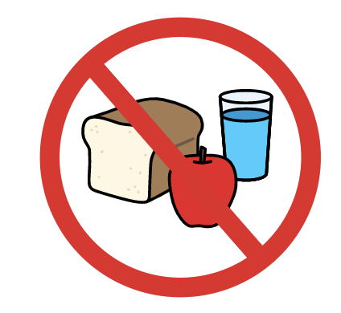
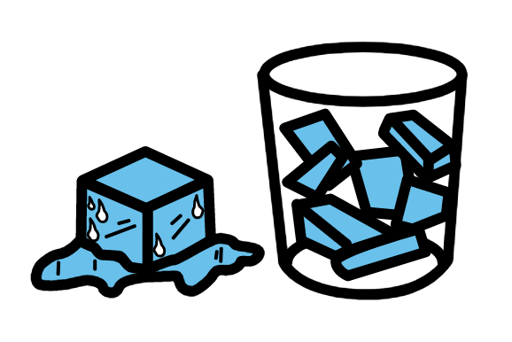
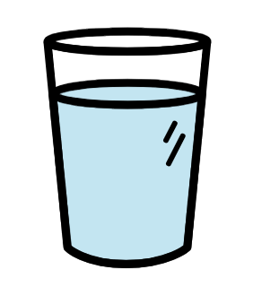
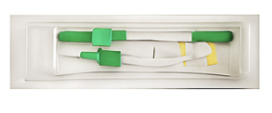
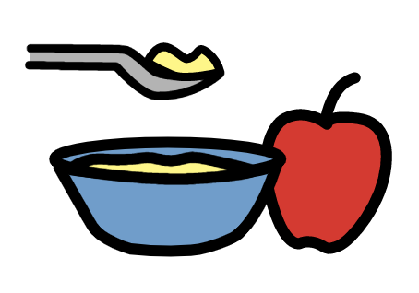
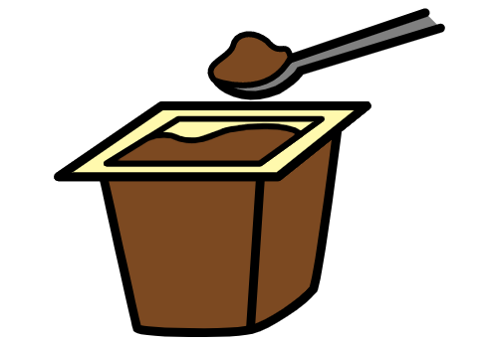
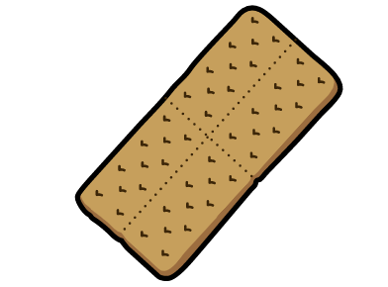
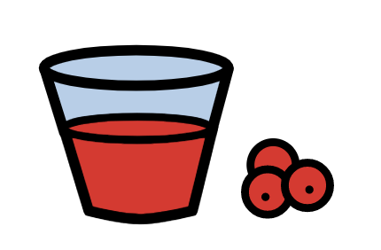

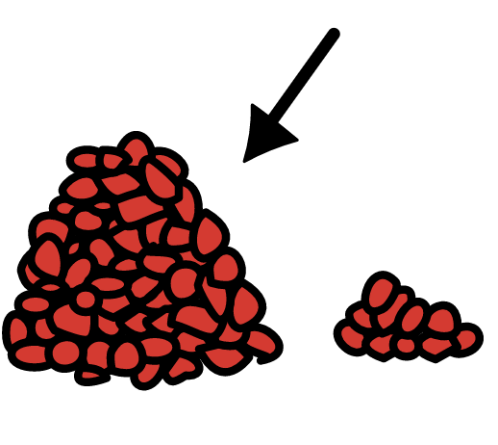


Nothing by mouth (NPO) | Oral care | Ice chips | Water
Applesauce | Pudding | Crackers | Juice
Stop | More | Something else | Letter Board
Maybe | Don’t Know | Later
Created by Tami Altschuler, NYU Langone Health (2025)
PCS is a trademark of Tobii Dynavox LLC. All rights reserved.
Used with permission.

