Slide 1
My Swallowing Test: VFSS (Videofluoroscopic Swallow Study)
Created by Tami Altschuler, NYU Langone Health (2025)

Slide 2


To see how I am eating and drinking and how to help me swallow.
Why am I having this test?

Slide 3
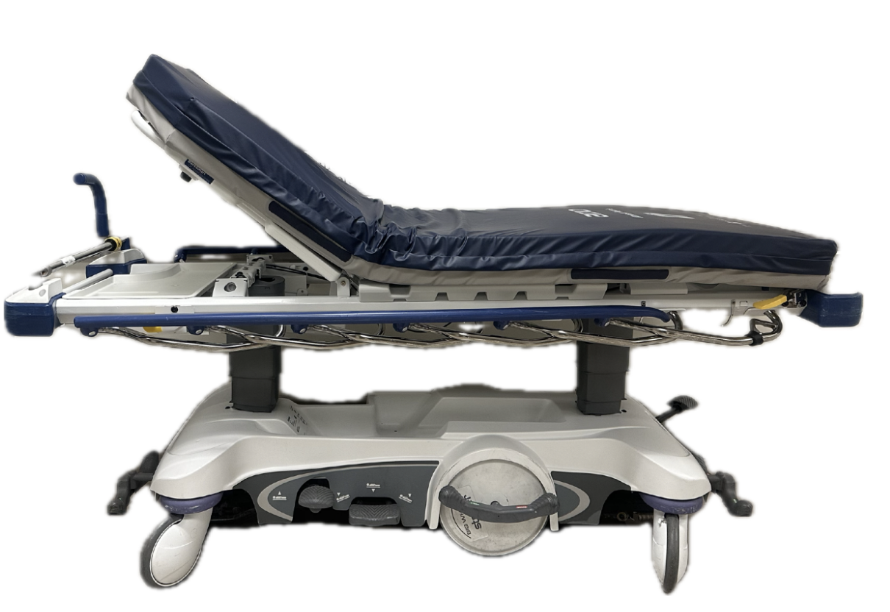
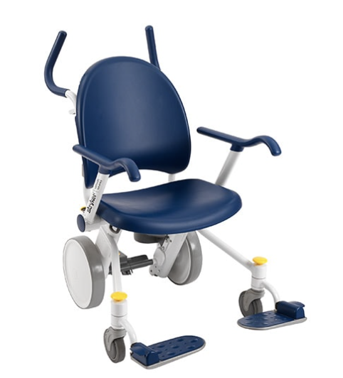
A transporter will bring me to Radiology on a stretcher or in a wheelchair.
Where is the test done?

Slide 4
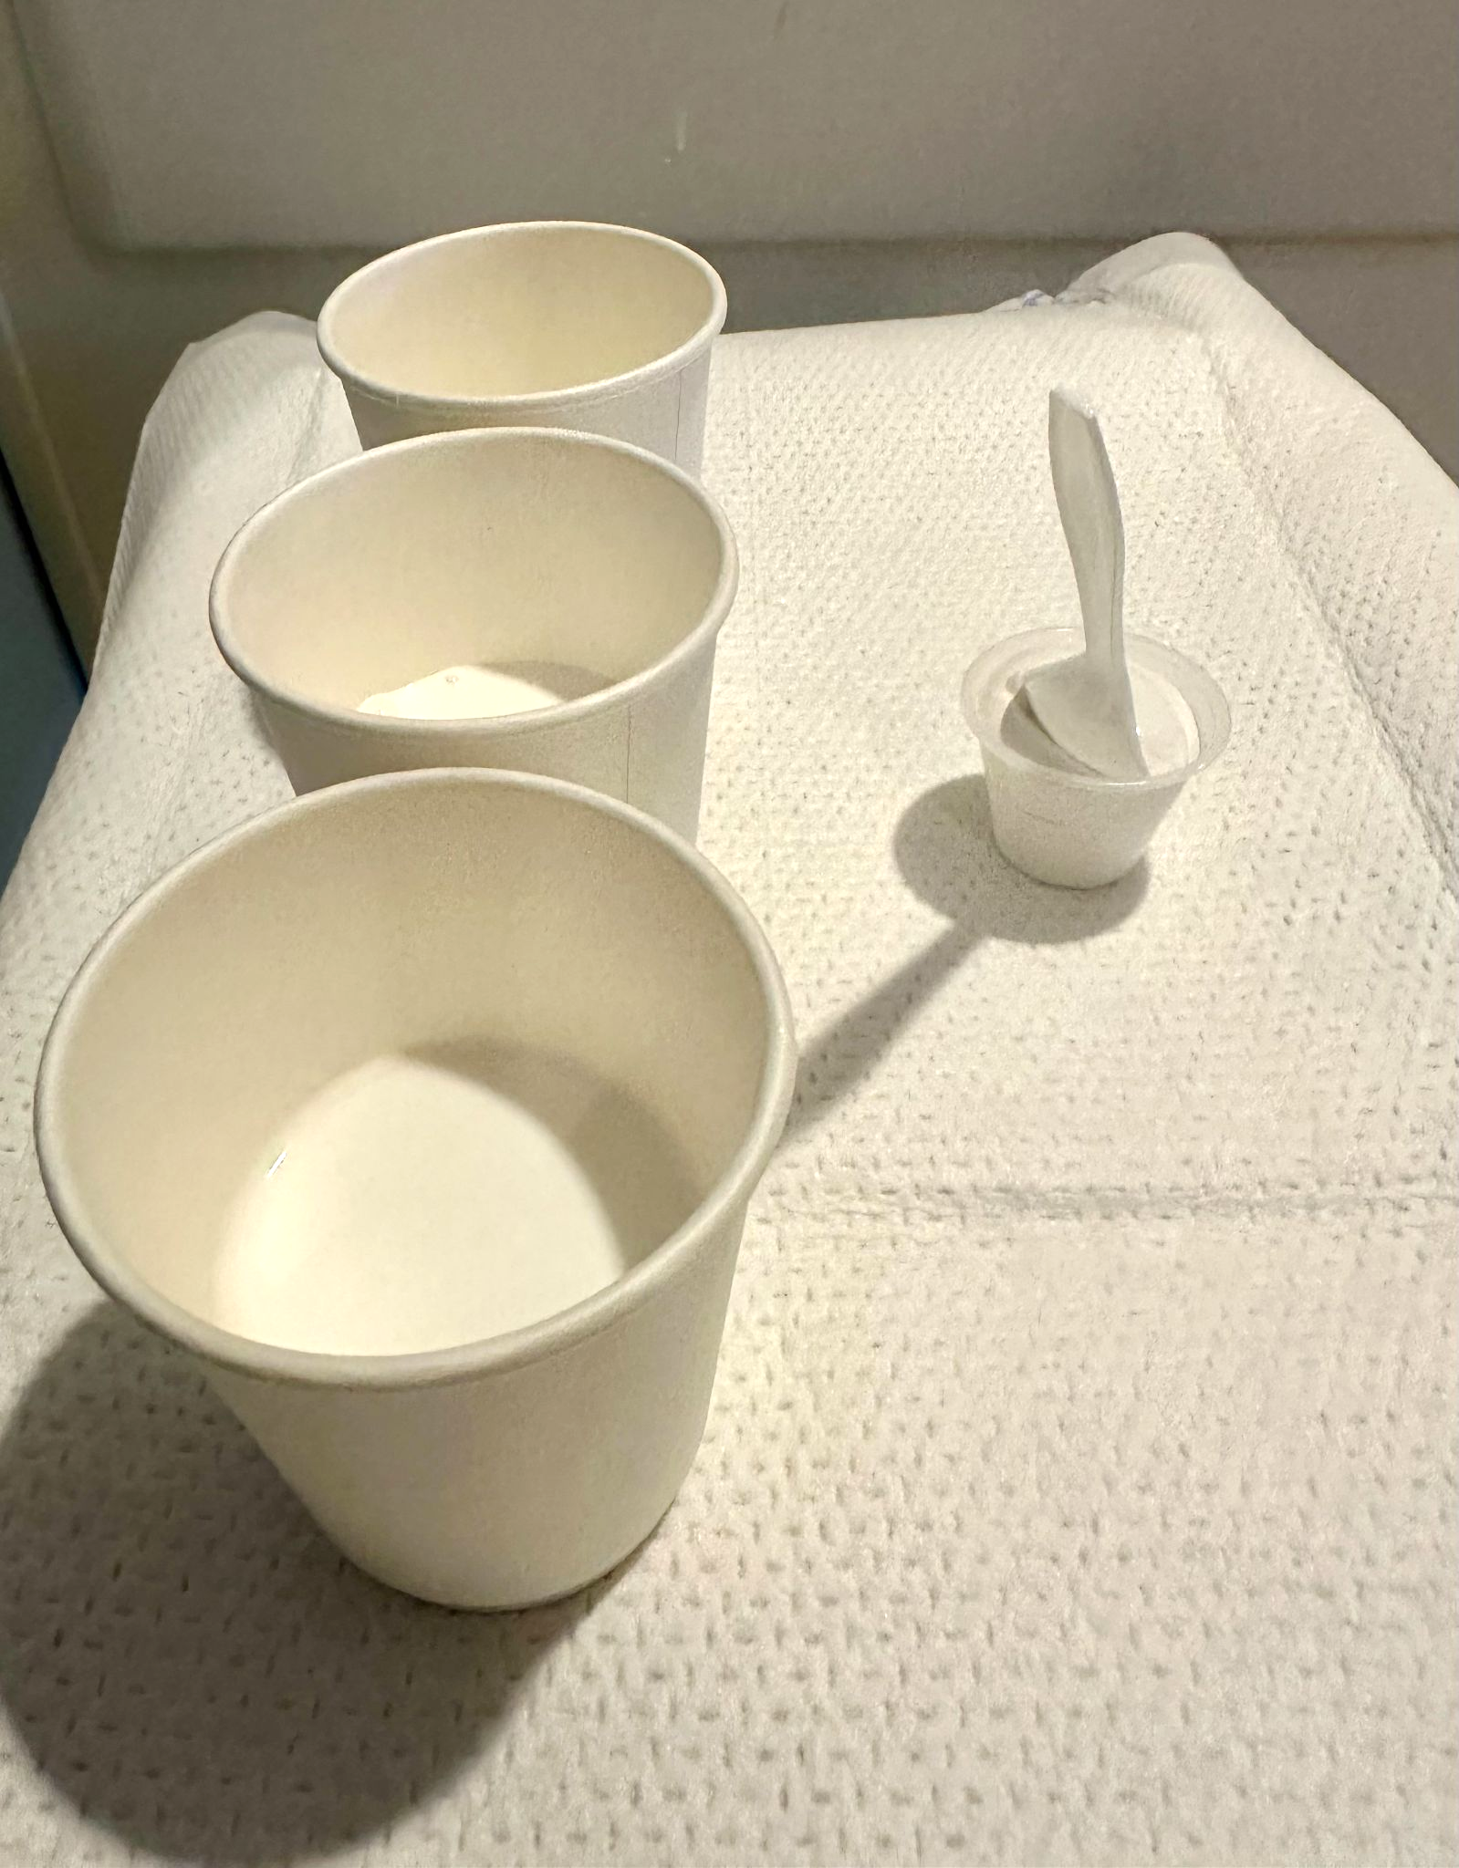
I will eat and drink different foods and liquids mixed with barium (contrast). They may taste a little chalky.
What do I do?

Slide 5
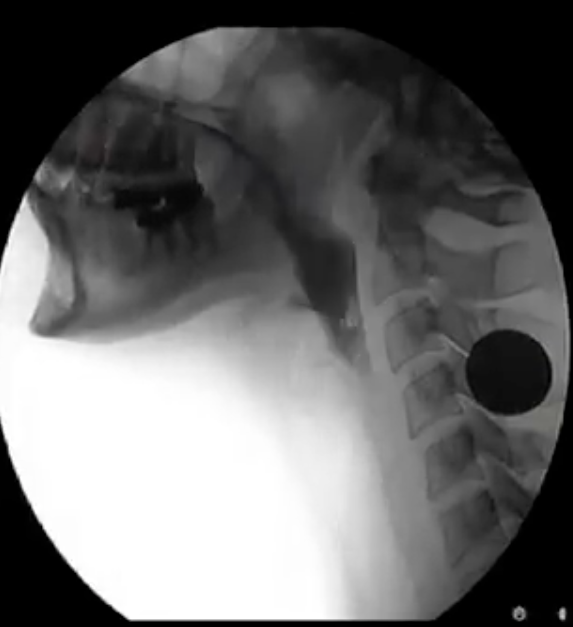
The camera takes a moving X-ray picture while I eat and drink.
It shows how the food and liquid travels down my throat.
What does the X-Ray see?

Slide 6
The SLP will talk to me about what they saw. They will make a plan with me about foods and liquids or if I need to wait to eat and drink.
What happens after the test?
SLP
Me

