Slide 1
My Swallowing Test: FEES (Fiberoptic Endoscopic Evaluation of Swallowing)
Created by Tami Altschuler, NYU Langone Health (2025)

Slide 2


To see how I am eating and drinking and how to help me swallow.
Why am I having this test?

Slide 3
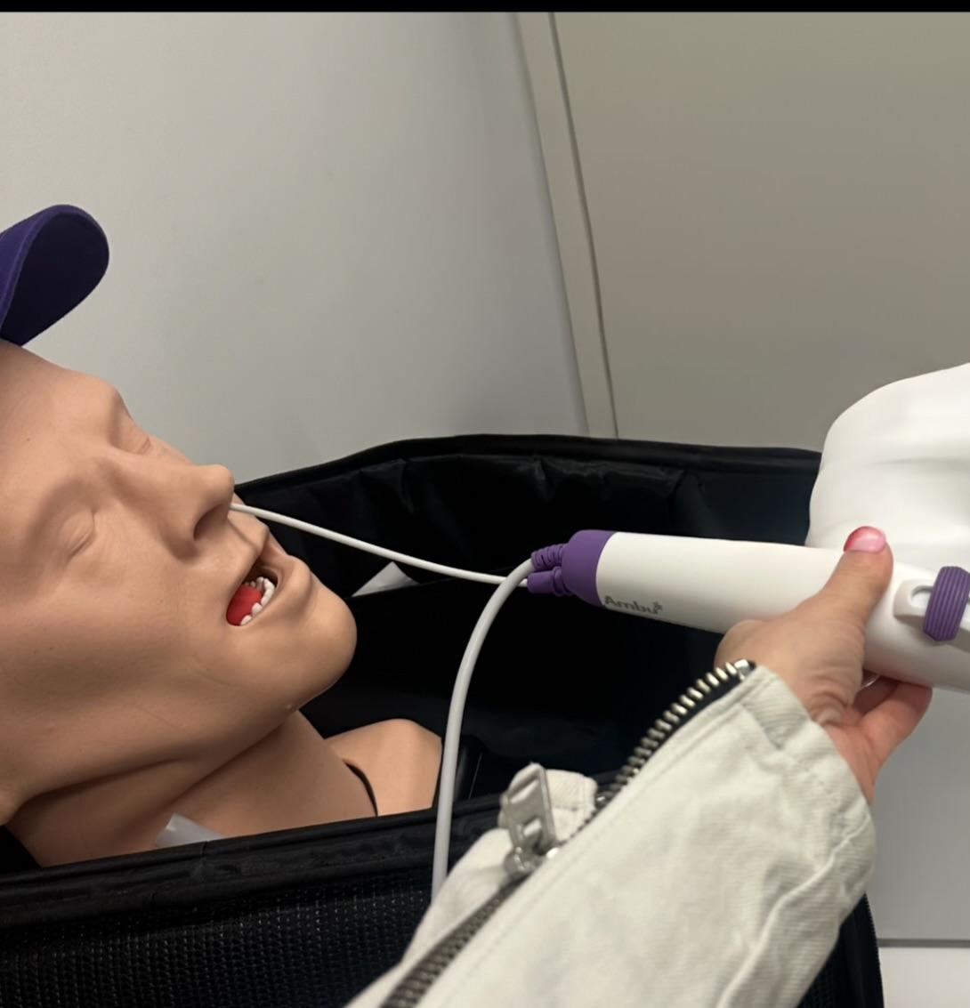
The SLP will gently place a small camera (like a bendy noodle)
in my nose. The camera lets
them see inside my throat.
How is the test done?

Slide 4
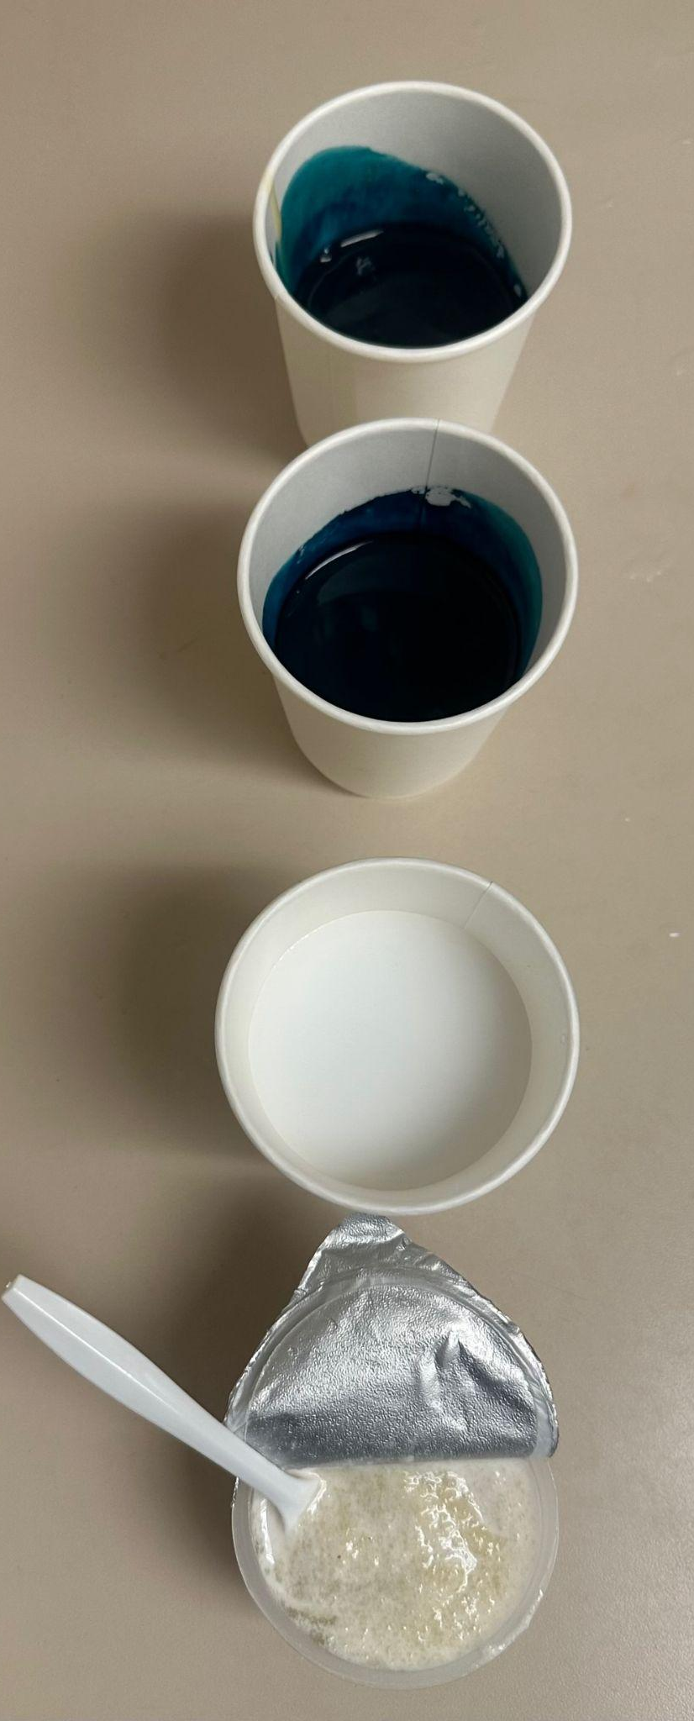
I will sit up in the chair or bed.
I will eat and drink different foods and liquids. The food coloring helps to see the swallows more clearly on the camera.
What do I do?

Slide 5
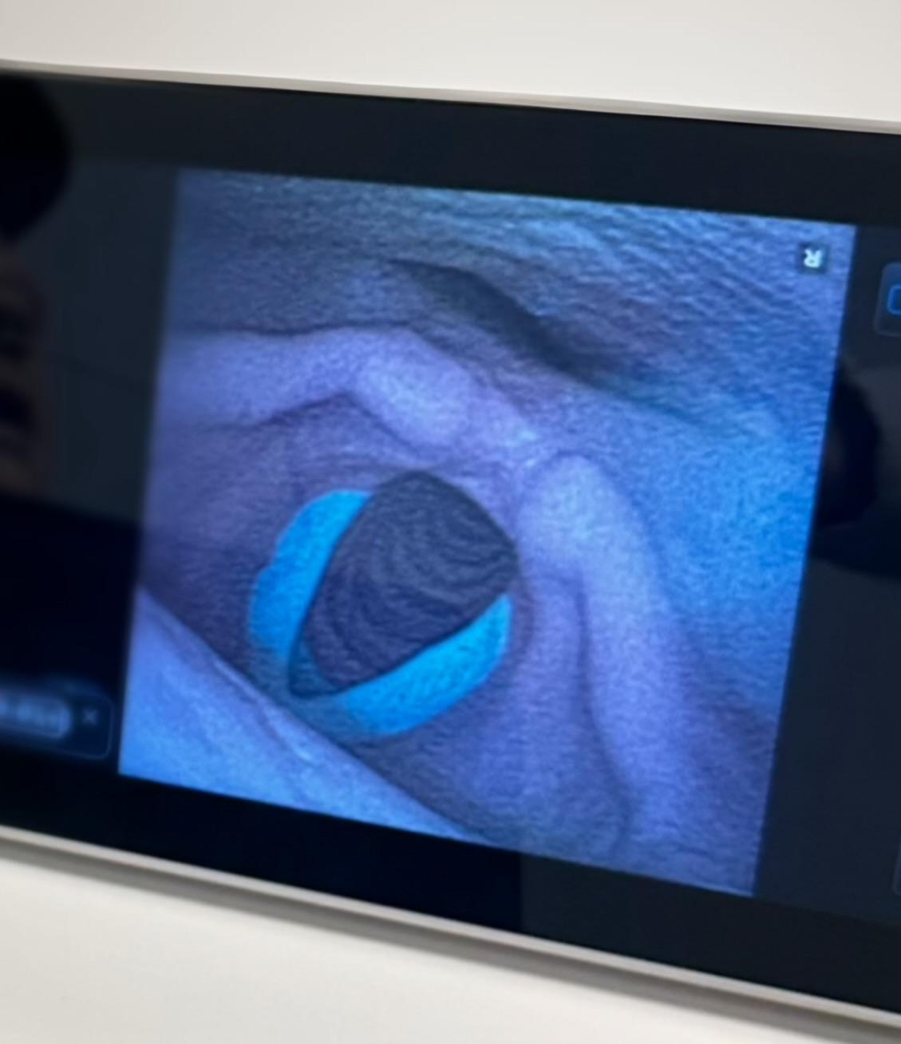
The camera looks down into
my throat and shows how food and liquid go down. I may feel a tickle or some pressure in my nose but it won’t last long. I will still be able to breathe and use my voice.
What does the camera see?

Slide 6
The camera will come out. The SLP will talk to me about what they saw. They will make a plan with me about foods and liquids or if I need to wait to eat and drink.
What happens after the test?
Me
SLP

