Slide 1
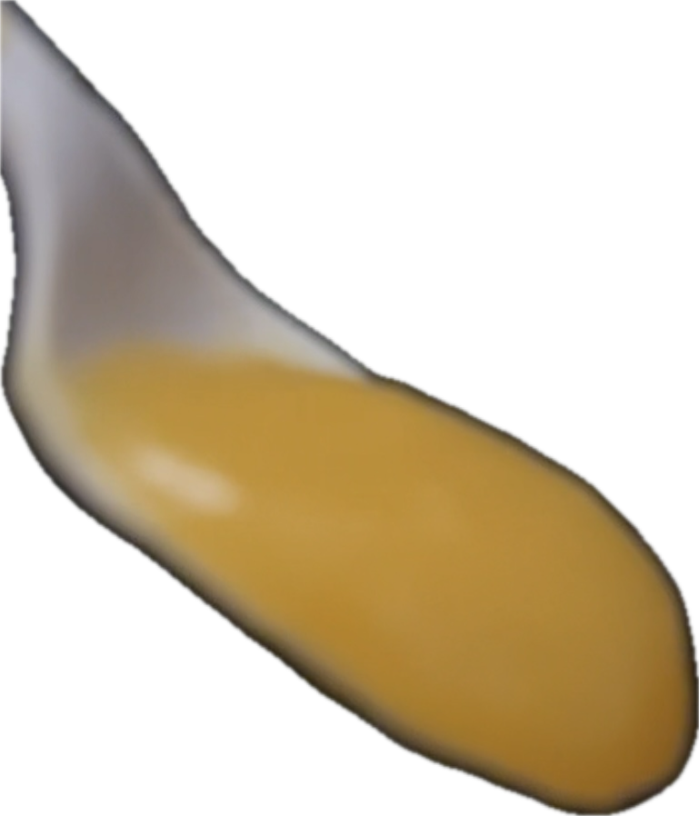
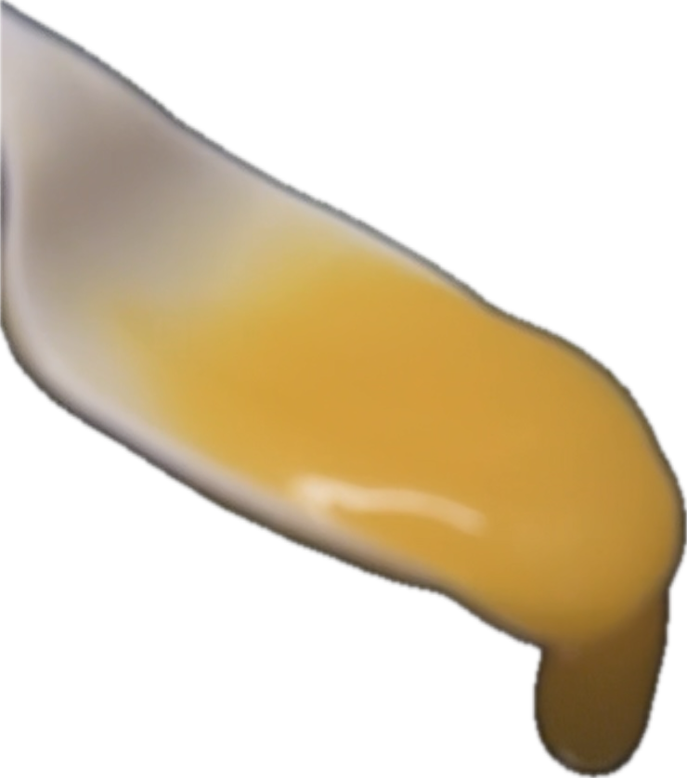
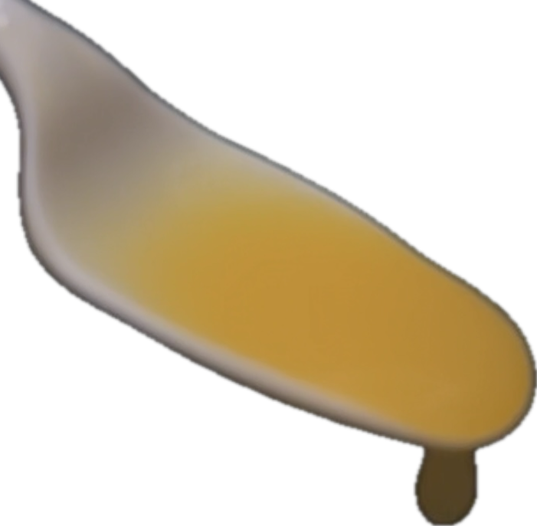
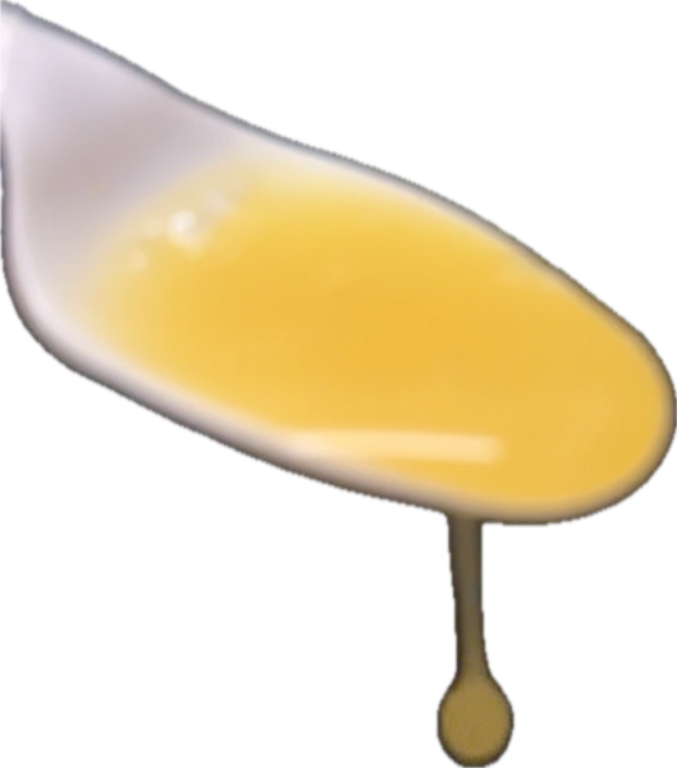
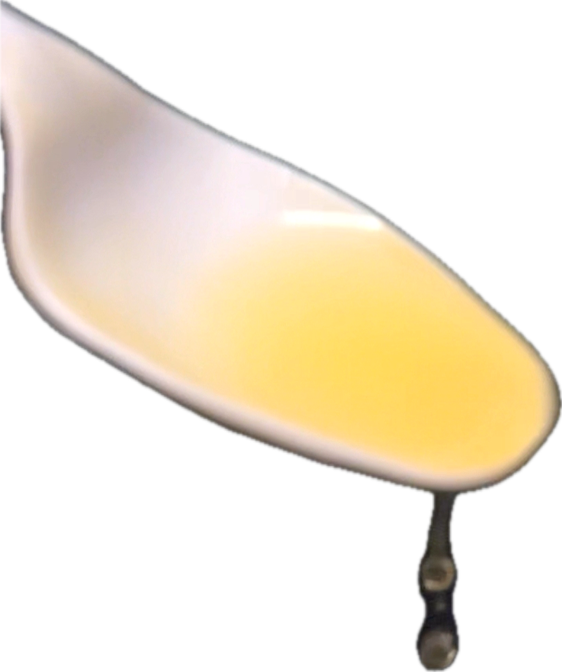
Extremely Thick | Moderately Thick | Mildly Thick | Slightly Thick | Thin
Created by Tami Altschuler, NYU Langone Health (2025)
Notes:
© The International Dysphagia Diet Standardisation Initiative 2019 @ https://iddsi.org/standards//framework. Licensed under the CreativeCommons Attribution Sharealike 4.0 License https://creativecommons.org/licenses/by-sa/4.0/legalcode. Derivative works extending beyond language translation are NOT PERMITTED.
https://www.iddsi.org/resources/guidelines-for-use

Slide 2
Moderately Thick | Mildly Thick | Thin
Created by Tami Altschuler, NYU Langone Health (2025)
Notes:
© The International Dysphagia Diet Standardisation Initiative 2019 @ https://iddsi.org/standards//framework. Licensed under the CreativeCommons Attribution Sharealike 4.0 License https://creativecommons.org/licenses/by-sa/4.0/legalcode. Derivative works extending beyond language translation are NOT PERMITTED.
https://www.iddsi.org/resources/guidelines-for-use

Slide 3
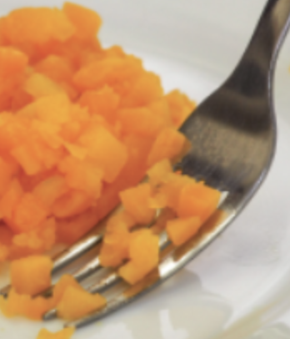

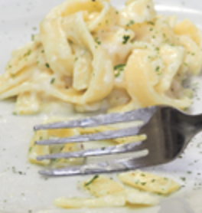
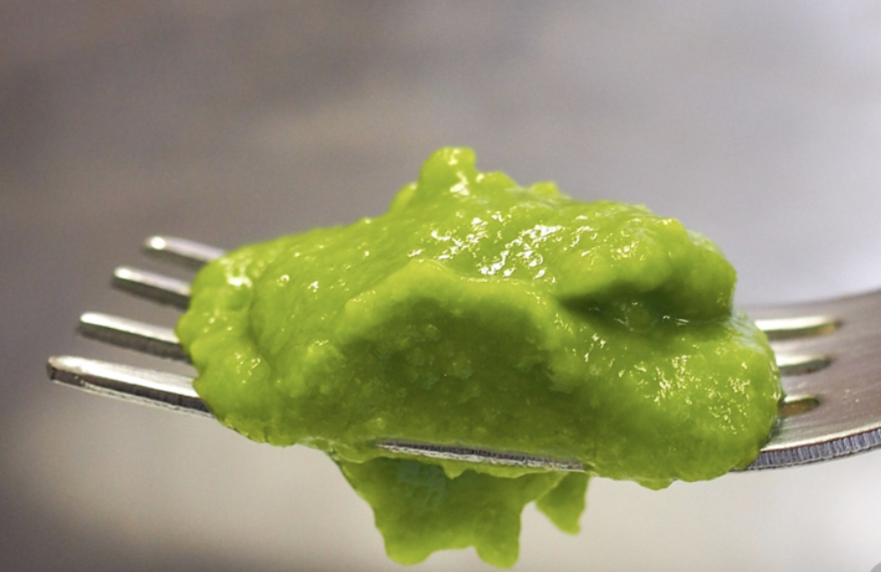
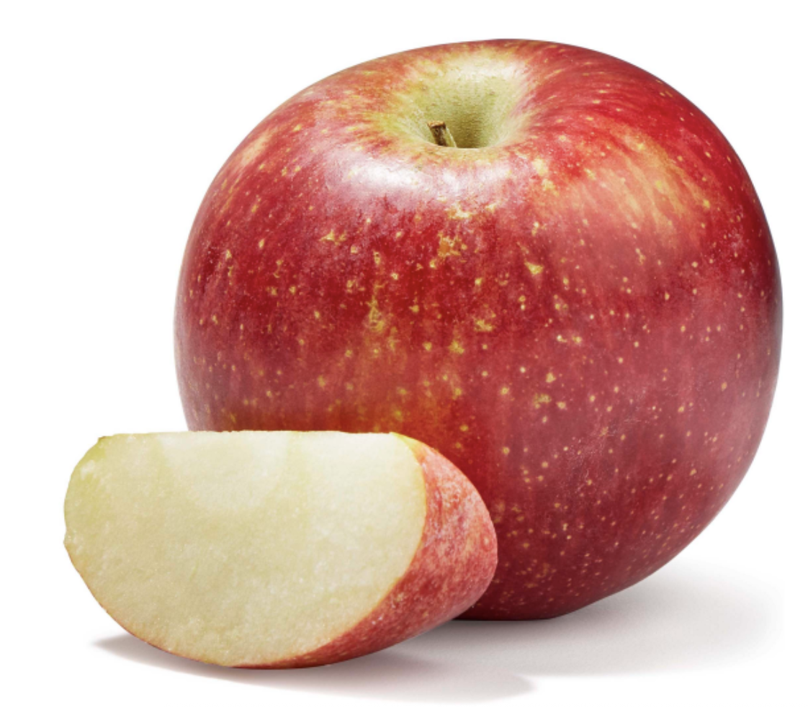
Liquidized | Pureed | Minced & Moist | Soft & Bite Sized | Easy to Chew | Regular
Images source: Roche Dietitians
(https://www.rochedietitians.com/iddsi)
Created by Tami Altschuler, NYU Langone Health (2025)
Notes:
https://www.rochedietitians.com/blog/2020/7/20/your-guide-to-iddsi-1
© The International Dysphagia Diet Standardisation Initiative 2019 @ https://iddsi.org/standards//framework. Licensed under the CreativeCommons Attribution Sharealike 4.0 License https://creativecommons.org/licenses/by-sa/4.0/legalcode. Derivative works extending beyond language translation are NOT PERMITTED.
https://www.iddsi.org/resources/guidelines-for-use

Slide 4
Pureed | Minced & Moist | Easy to Chew | Regular
Images source: Roche Dietitians (https://www.rochedietitians.com/iddsi)
Created by Tami Altschuler, NYU Langone Health (2025)
Notes:
© The International Dysphagia Diet Standardisation Initiative 2019 @ https://iddsi.org/standards//framework. Licensed under the CreativeCommons Attribution Sharealike 4.0 License https://creativecommons.org/licenses/by-sa/4.0/legalcode. Derivative works extending beyond language translation are NOT PERMITTED.
https://www.iddsi.org/resources/guidelines-for-use

