Slide 1


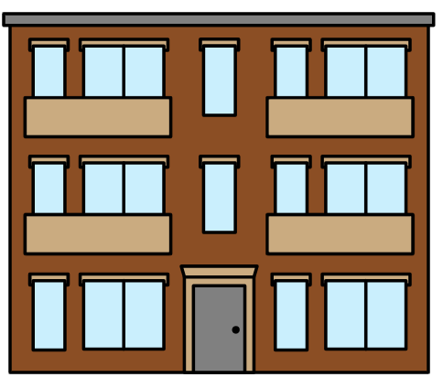
Eat more
Get stronger
Go home
.
I need to eat more, get stronger, and go home.
PCS is a trademark of Tobii Dynavox LLC. All rights reserved.
Used with permission.
Created by Tami Altschuler, NYU Langone Health (2025)

