Slide 1
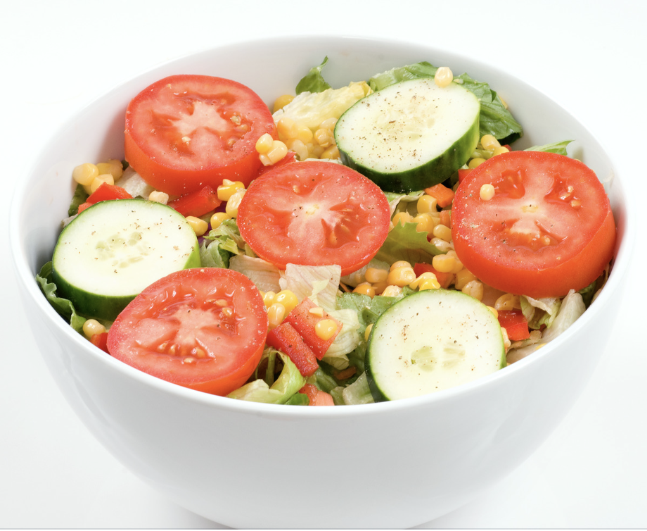
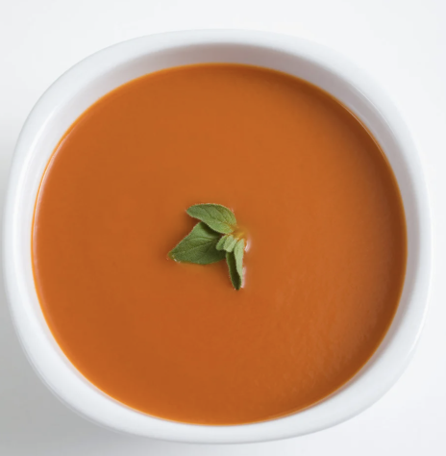
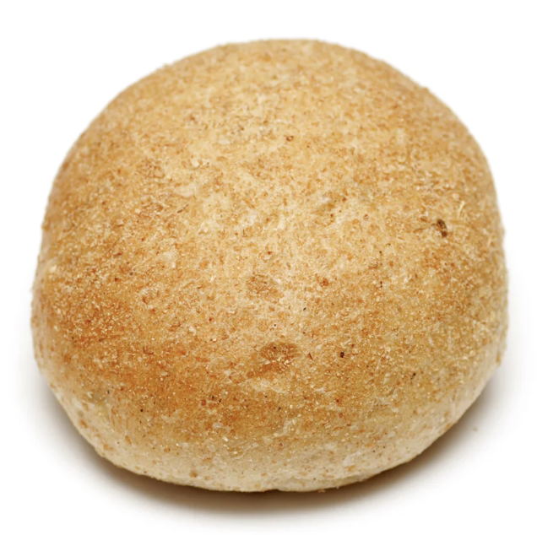
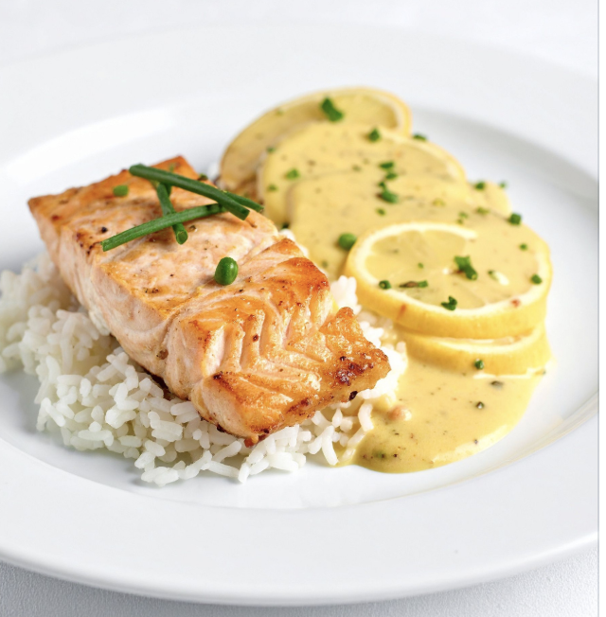
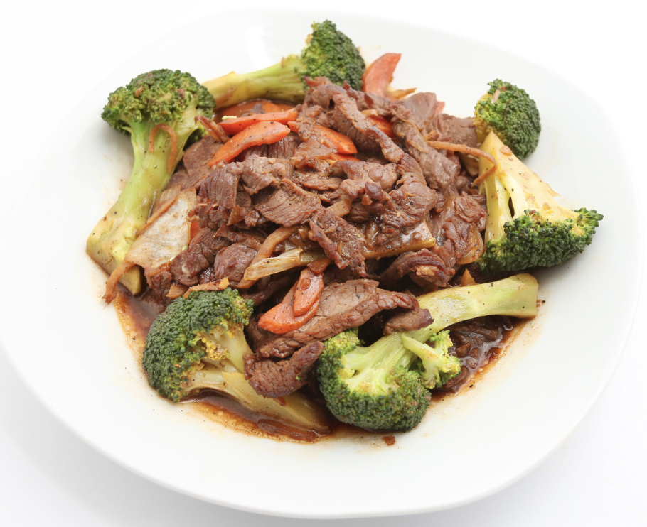
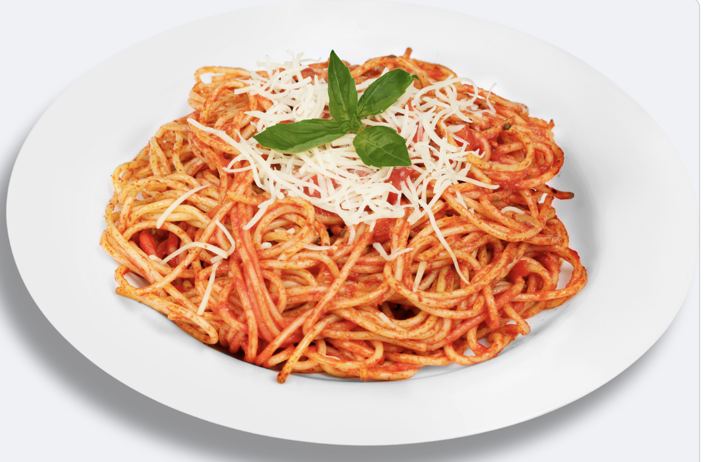
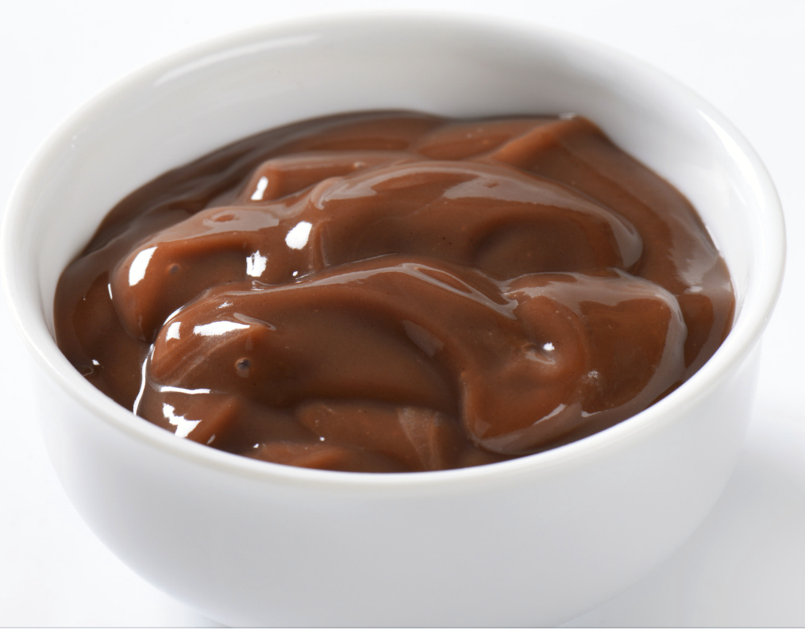

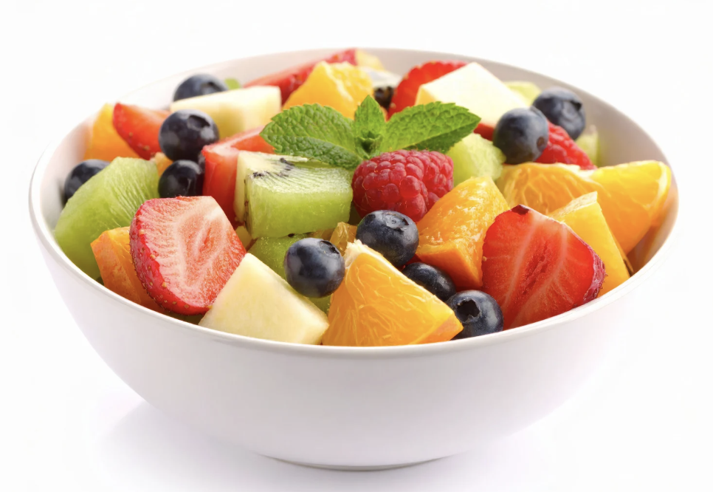
Appetizer
Entree
Dessert
Salad
Tomato soup
Roll
Salmon with rice
Beef and broccoli
Spaghetti with sauce
Chocolate pudding
Gelatin
Mixed fruit
I want this | I don’t want this | Something else
Created by Tami Altschuler, NYU Langone Health (2025)

