Slide 1
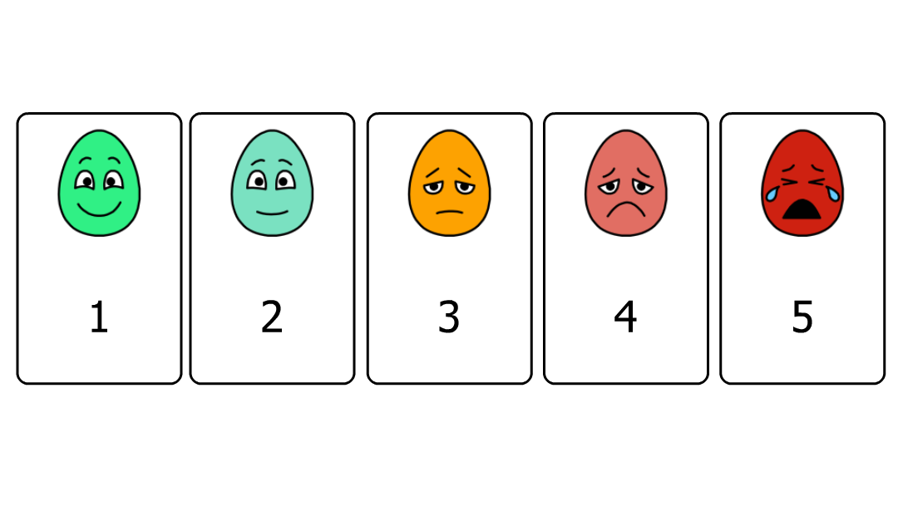
Pediatric Pain Scale

Slide 2
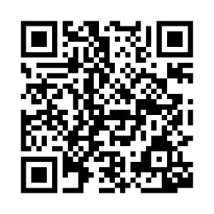
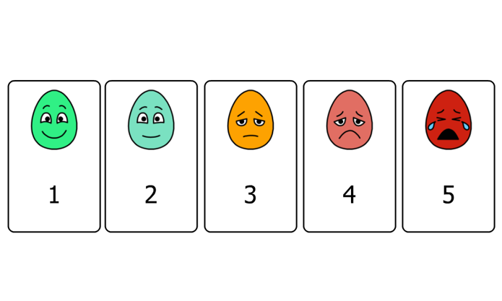
If it’s hard for to point, please use “partner-assisted scanning”
This is how:
Ask patient to focus on the communication board
Establish patient’s “yes” (i.e. nodding, blinking, thumbs up, etc.)
1. Scan through the pain scale options
2. Patient will choose pain scale number row using YES response
3. Confirm the selection & repeat
Additional Considerations:
Hold this tool ~12 inches from the patient’s face
Ensure good lighting, head positioning, and vision
Speak loudly and clearly using simple language
Wearing masks and other PPE may make it difficult to understand speech. Consider using communication tools when speaking to the patient as well.
If the patient can’t use this tool effectively now, that does not mean they won’t be able to use it later today, tomorrow, or this week. Continue to provide opportunities to support communication.
Partner-Assisted Scanning Instructions – message board

