Slide 1
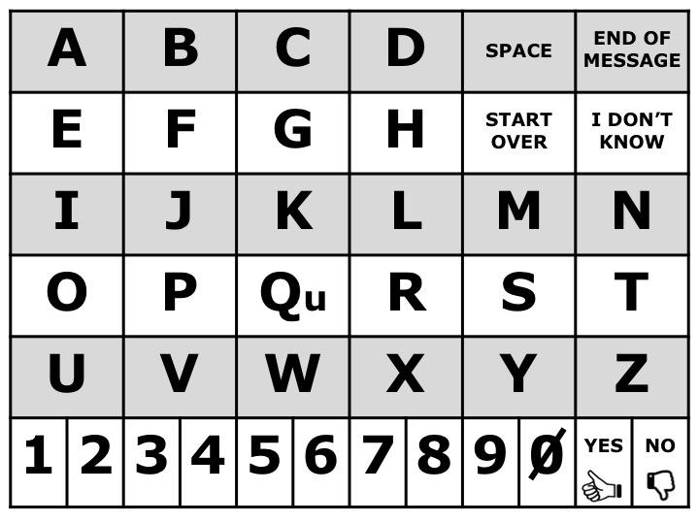
Letter Board - AEIOU format
Notes:
AEIOU Letter Board

Slide 2
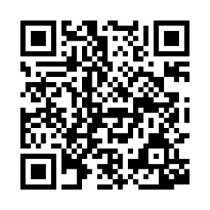
If it’s hard for patient to point, please use partner-assisted scanning
This is how:
Ask patient to think of a message to spell (simple, single word messages are often best).
Establish the patient’s “yes” (i.e. nodding, blinking, thumbs up, etc.).
1. Cue the patient to focus on the 1st letter of the word.
2. Proceed row by row. Point to each row and ask if the letter is in that row.
(e.g. point to 1st row and ask, “Is it in this row?” followed by 2nd row, and so on)
3. Patient will select a row using the established YES response. Verify the choice out loud.
4. Point to each letter within the selected row (“Is it A, B, C, D?”).
5. Patient will signal the desired letter using the established YES response.
6. Confirm the selection & repeat.
Additional Considerations:
Hold this tool ~12 inches (~30 cm) from the patient’s face.
Ensure good lighting, head positioning, and vision.
Speak loudly and clearly using simple language.
Wearing masks and other PPE may make it difficult to understand speech. Consider using communication tools when speaking to the patient as well.
If the patient can’t use this tool effectively now, that does not mean the patient won’t be able to use it later today, tomorrow, or this week. Continue to provide opportunities to support communication.
Partner-Assisted Scanning Instructions – Letter board

Slide 3
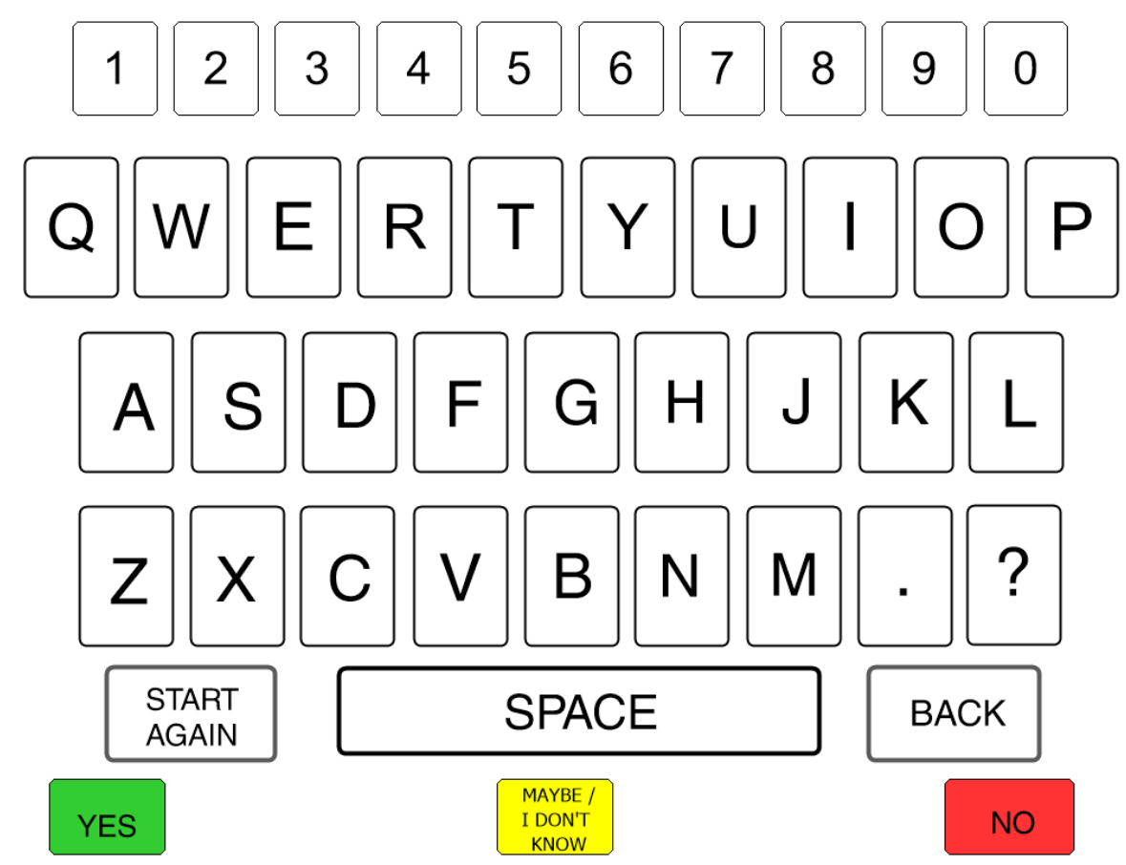
Letter Board – QWERTY format

Slide 4
If it’s hard for patient to point, please use partner-assisted scanning
This is how:
Ask patient to think of a message to spell (simple, single word messages are often best).
Establish the patient’s “yes” (i.e. nodding, blinking, thumbs up, etc.).
1. Cue the patient to focus on the 1st letter of the word.
2. Proceed row by row. Point to each row and ask if the letter is in that row.
(e.g. point to 1st row and ask, “Is it in this row?” followed by 2nd row, and so on)
3. Patient will select a row using the established YES response. Verify the choice out loud.
4. Point to each letter within the selected row (“Is it A, B, C, D?”).
5. Patient will signal the desired letter using the established YES response.
6. Confirm the selection & repeat.
Additional Considerations:
Hold this tool ~12 inches (~30 cm) from the patient’s face.
Ensure good lighting, head positioning, and vision.
Speak loudly and clearly using simple language.
Wearing masks and other PPE may make it difficult to understand speech. Consider using communication tools when speaking to the patient as well.
If the patient can’t use this tool effectively now, that does not mean the patient won’t be able to use it later today, tomorrow, or this week. Continue to provide opportunities to support communication.
Partner-Assisted Scanning Instructions – Letter board

