Slide 1
Comprehension Supports for Patients

Slide 2
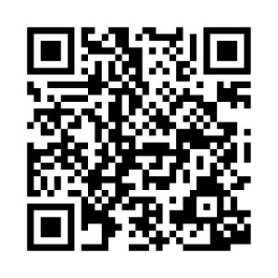
Comprehension Supports for Patients:
Purpose
These communication tools are intended for patients that are admitted to a hospital and require additional resources to access health care safely.
Populations may include, but are not limited to, patients with Autism Spectrum Disorder, intellectual disabilities, Dementia, Aphasia, pediatric patients, or those with altered cognition.
Supports are intended to be customizable.
  For example, you may consider asking family or caregivers to electronically provide pictures that can be inserted in the “I LIKE” page.

Slide 3
Comprehension Supports for Patients:
Instructions
Print and bind resources together as a booklet (e.g. hole punch and place into binder or staple together)
Orient all communication partners to topic/communication board
  How to use:
    “First, Then, Done” boards: Point to the intended photos and state instructions using simplified language. For example, "First eat. Then game." or "First wait. Then drink."
    "I Like” board: Consider writing terms for and obtaining electronic pictures of special interests. (i.e. trusted individuals, TV, objects that provide comfort)
    "Wait and Go” cue card: Print and fold the page. Use to cue patient and regulate interactions or cares.
Identify access method – How will the patient choose a message? (e.g. pointing, indicating “yes” given choices, etc.) For instructions on partner-assisted scanning, please see the next page.
Read selected messages aloud to ensure selection accuracy
Ask follow up questions
Explore emotions and reactions
Allow extra time for the patient to respond

Slide 4
If it’s hard for patient to point, please use “partner-assisted scanning”
This is how:
Ask patient to focus on the communication board and find the message they want to communicate.
Establish patient’s “yes” (i.e. nodding, blinking, thumbs up, etc.)
1. Proceed row by row. Point to each row and ask if the desired message is in that row
(e.g. point to 1st row and ask, “Is it in this row?” followed by 2nd row, and so on)
2. Patient will select a row using the established YES response. Verify the choice out loud.
3. Point to each message within the selected row (“Is it suction?” “Trouble breathing,” etc.).
4. Patient will signal that you are pointing to the desired message using established YES response.
5. Confirm the selection & repeat.
Additional Considerations:
Hold this tool ~12 inches (~30 cm) from the patient’s face.
Ensure good lighting, head positioning, and vision.
Speak loudly and clearly using simple language.
Wearing masks and other PPE may make it difficult to understand speech. Consider using communication tools when speaking to the patient as well.
If the patient can’t use this tool effectively now, that does not mean the patient won’t be able to use it later today, tomorrow, or this week. Continue to provide opportunities to support communication.
Partner-Assisted Scanning Instructions – message board

Slide 5
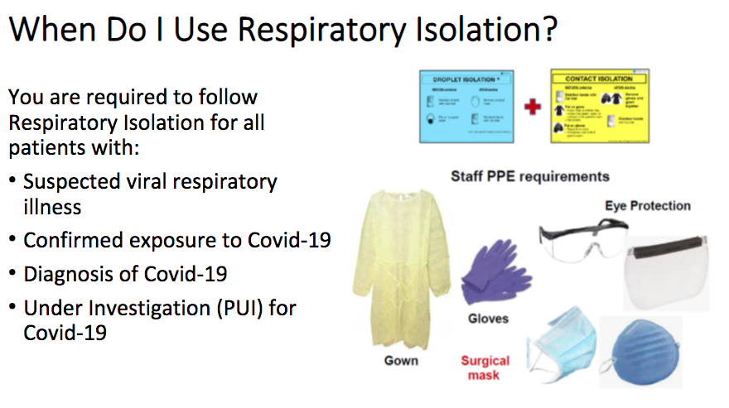
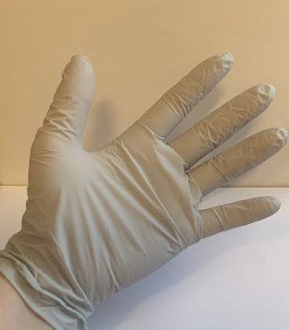
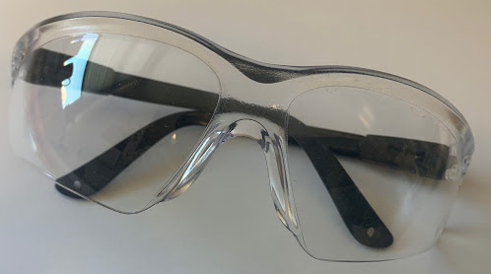
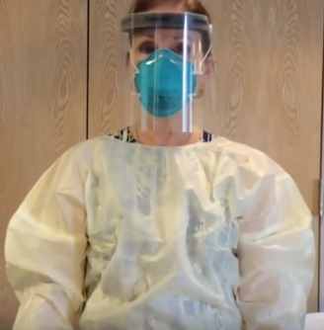
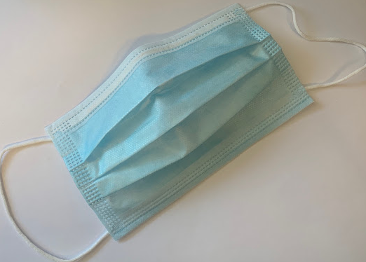
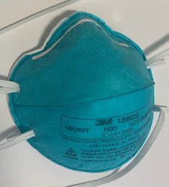
1 FIRST | 2 THEN | þ DONE
GLOVES
GOGGLES
CLOTHES
GOWN
MASKS
Point to targets, starting with “First + item/activity,” to tell your patient what is about to happen. Say the message out loud as you point. For example, "First eat. Then game." or "First temperature. Then blood pressure. Done."
Notes:
switched out the pictures for clearer ones provided by Sarah G. Additional are in the AAC Materials Folder.

Slide 6
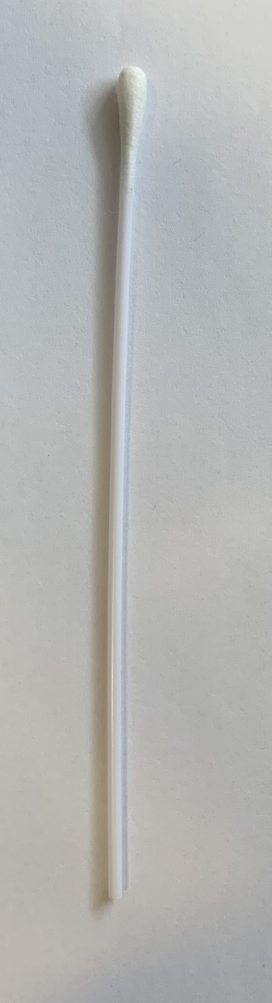
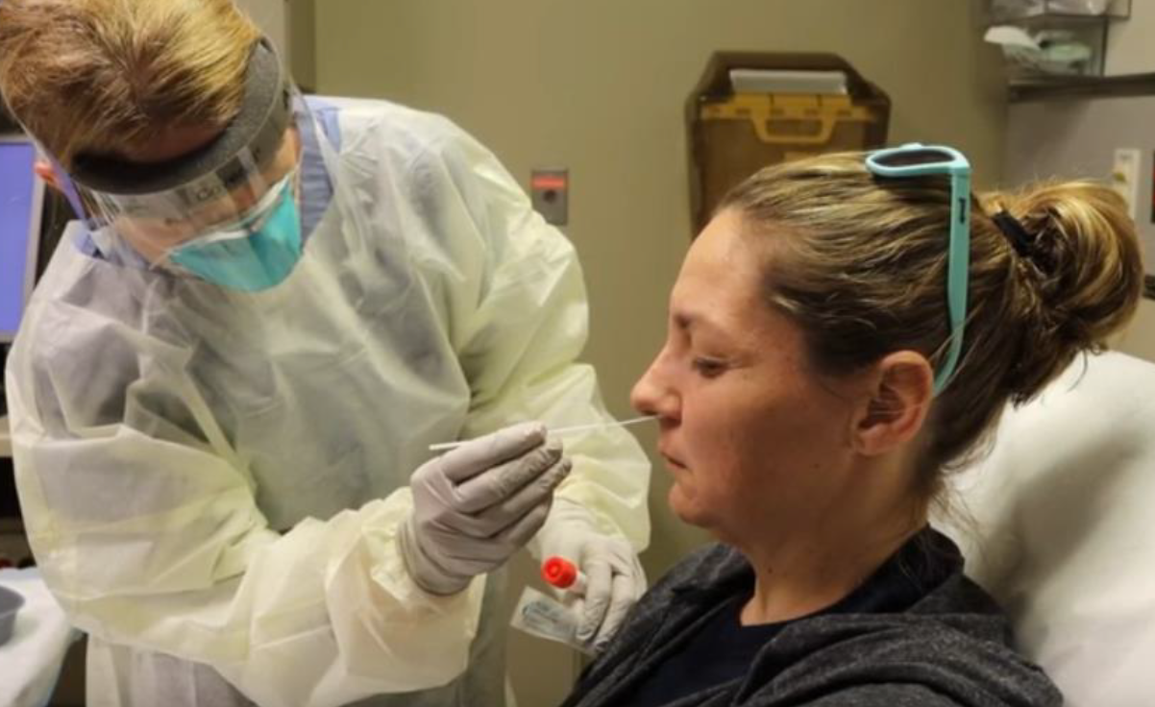
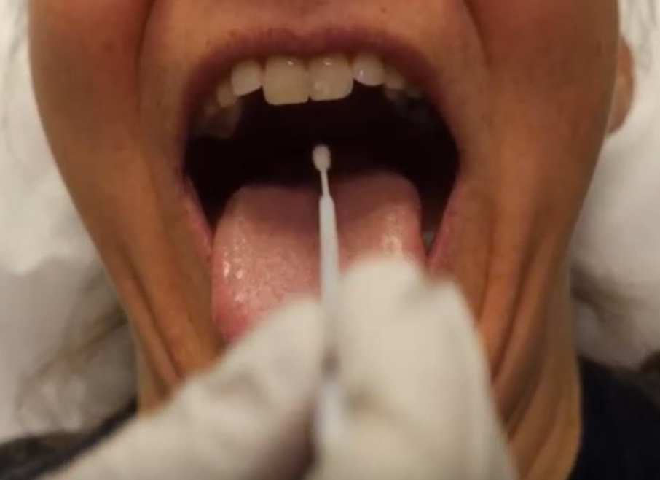
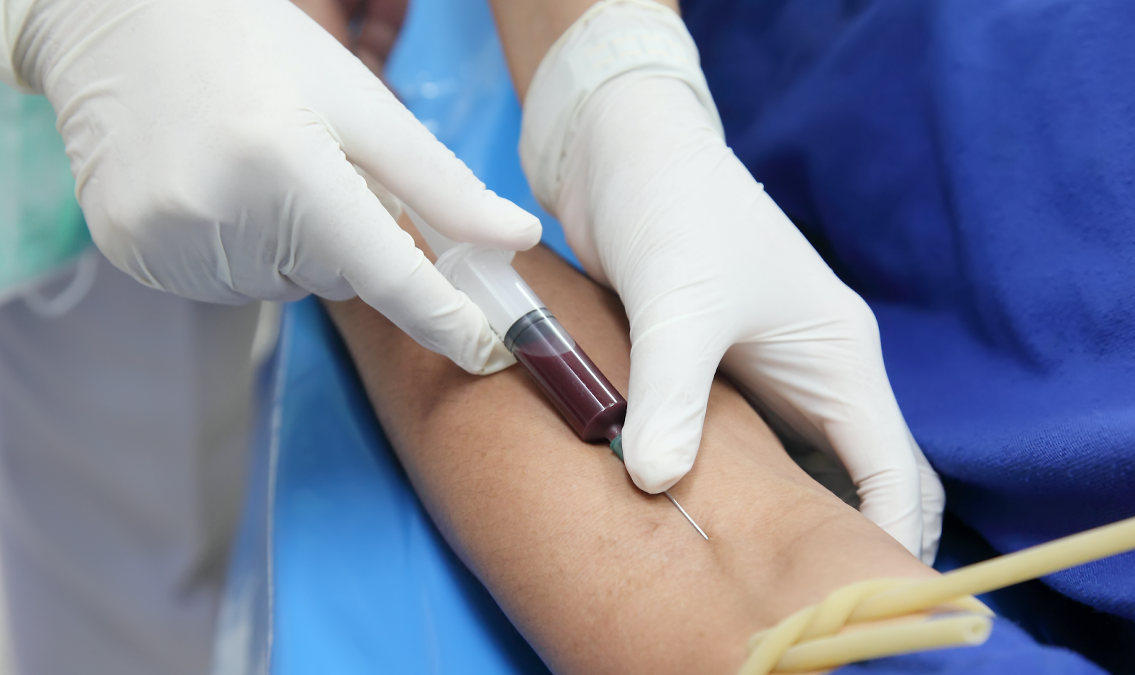
1 FIRST | 2 THEN | þ DONE
COTTON SWAB
NOSE
COVID TEST
MOUTH
BLOOD
Point to targets, starting with “First + item/activity,” to tell your patient what is about to happen. Say the message out loud as you point. For example, "First eat. Then game." or "First temperature. Then blood pressure. Done."

Slide 7
1 FIRST | 2 THEN | þ DONE
COVID TEST
A nurse wearing
special clothes will
give me a test.
The nurse will put a Q-tip in my nose.
The nurse will put a Q-tip in my throat.
The nurse may poke
my arm.
OR
AND
My doctors and nurses need to find out why I’m sick.
It may feel strange. It’s okay. I will sit still. It will be over soon.
Point to targets, starting with “First + item/activity,” to tell your patient what is about to happen. Say the message out loud as you point. For example, "First eat. Then game." or "First temperature. Then blood pressure. Done."

Slide 8
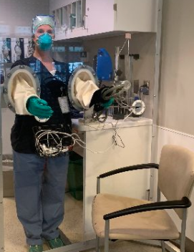
1 FIRST | 2 THEN | þ DONE
COVID TEST WITH SAFETY WALL
A nurse wearing
special clothes will
give me a test.
The nurse will put a Q-tip in my nose.
The nurse will put a Q-tip in my throat.
The nurse may poke
my arm.
OR
AND
My doctors and nurses need to find out why I’m sick.
It may feel strange. It’s okay. I will sit still. It will be over soon.
Point to targets, starting with “First + item/activity,” to tell your patient what is about to happen. Say the message out loud as you point. For example, "First eat. Then game." or "First temperature. Then blood pressure. Done."

Slide 9
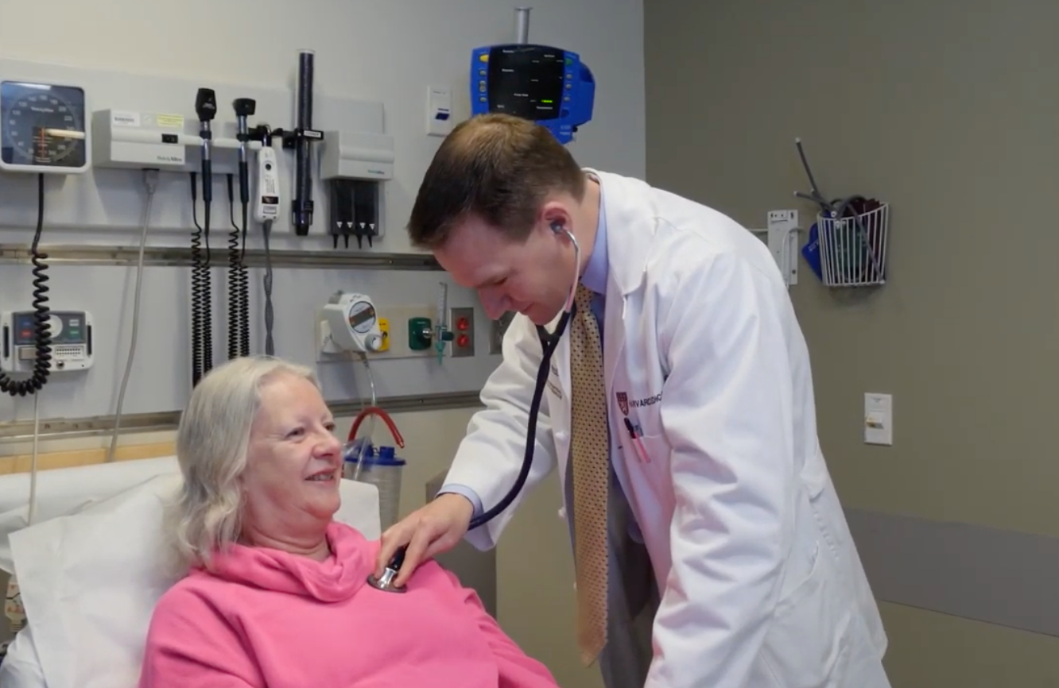
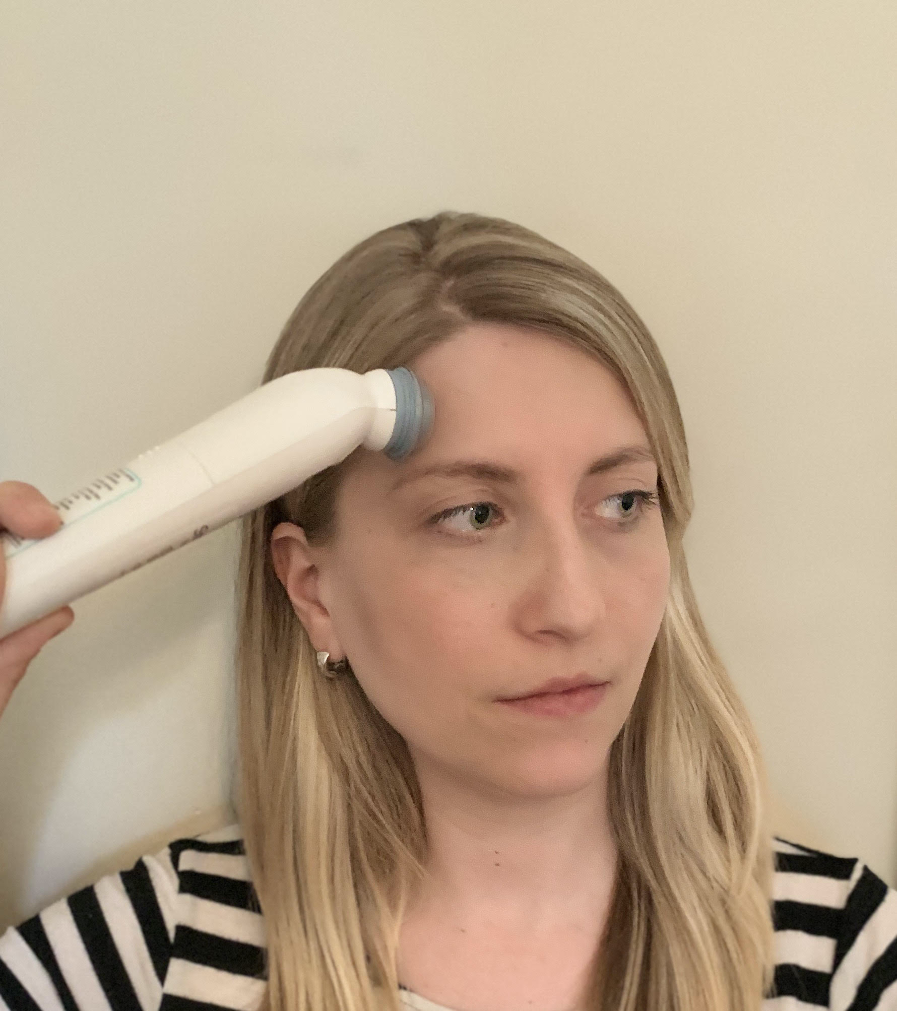
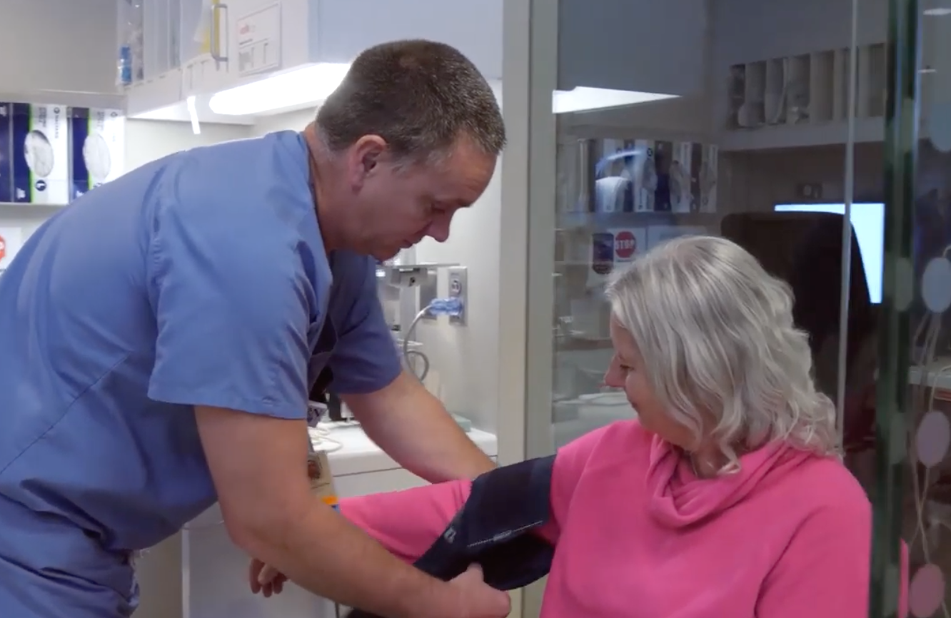
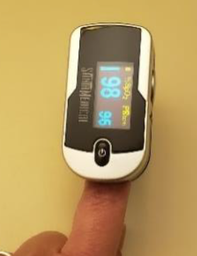
1 FIRST | 2 THEN | þ DONE
LISTEN TO BREATH
TEMPERATURE
VITALS
BLOOD PRESSURE
CHECK OXYGEN
Point to targets, starting with “First + item/activity,” to tell your patient what is about to happen. Say the message out loud as you point. For example, "First eat. Then game." or "First temperature. Then blood pressure. Done."

Slide 10
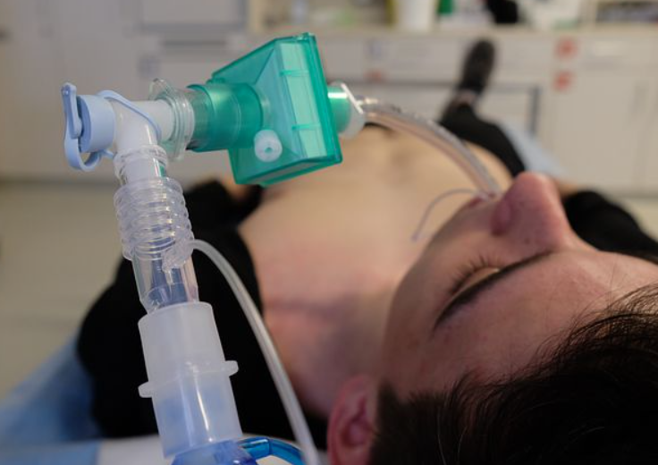
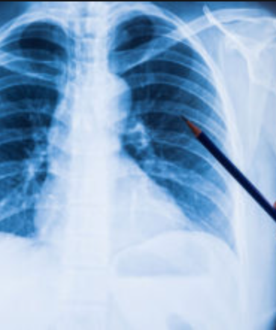
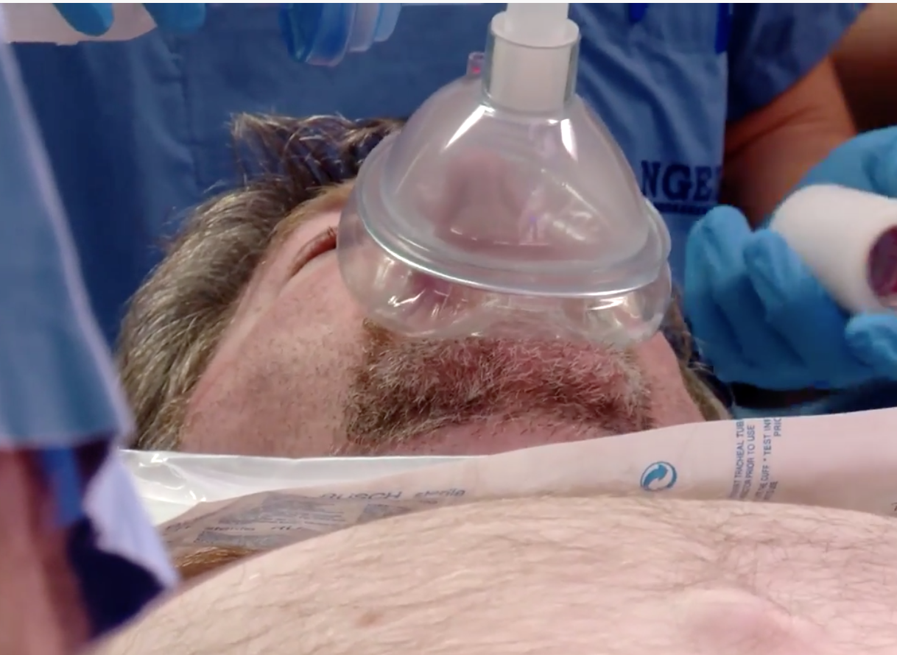
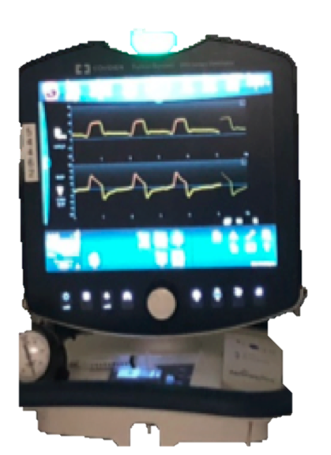
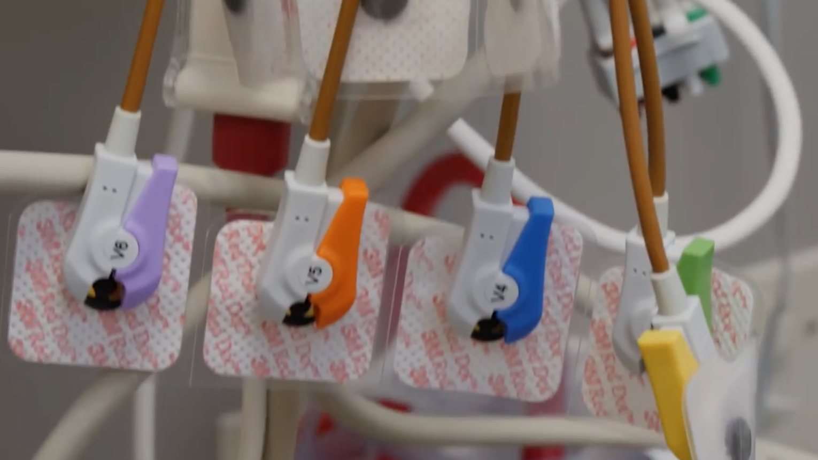
1 FIRST | 2 THEN | þ DONE
BREATHING TUBE TUBE
CHEST SCAN
BLOOD / IV
IT’S TIME FOR
SLEEP MEDICINE
BREATHING MACHINE
EKG
Point to targets, starting with “First + item/activity,” to tell your patient what is about to happen. Say the message out loud as you point. For example, "First eat. Then game." or "First temperature. Then blood pressure. Done."

Slide 11
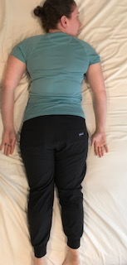
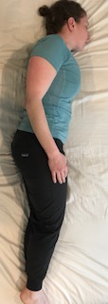
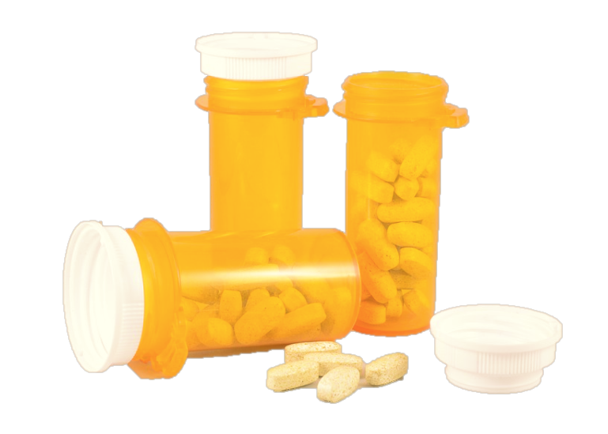
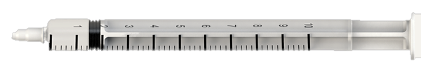
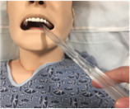
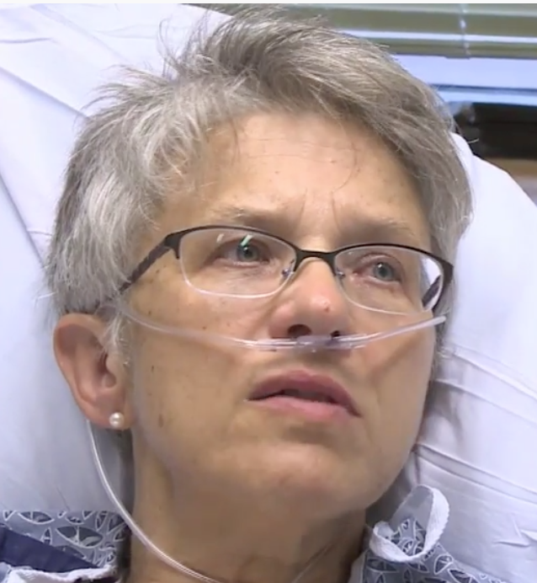
1 FIRST | 2 THEN | þ DONE
TAKE MEDICINE
LIE ON STOMACH
LIE ON SIDE
IT’S TIME TO
SUCTION
PUT TUBE IN NOSE
CHECK OXYGEN
Point to targets, starting with “First + item/activity,” to tell your patient what is about to happen. Say the message out loud as you point. For example, "First eat. Then game." or "First temperature. Then blood pressure. Done."
Notes:
find a different picture for meds

Slide 12

1 FIRST | 2 THEN | þ DONE
________
________
I LIKE
________
________
Add photos of interests and write in labels (i.e. people, comfort items, preferred activities, etc.). Point to targets, starting with “First + item/activity,” to tell your patient what is about to happen. Say the message out loud as you point (e.g. "First eat. Then game.”)

Slide 13
1 FIRST | 2 THEN | þ DONE
________
________
________
I LIKE
________
________
________
Add photos of interests and write in labels (i.e. people, comfort items, preferred activities, etc.). Point to targets, starting with “First + item/activity,” to tell your patient what is about to happen. Say the message out loud as you point (e.g. "First eat. Then game.”)

Slide 14


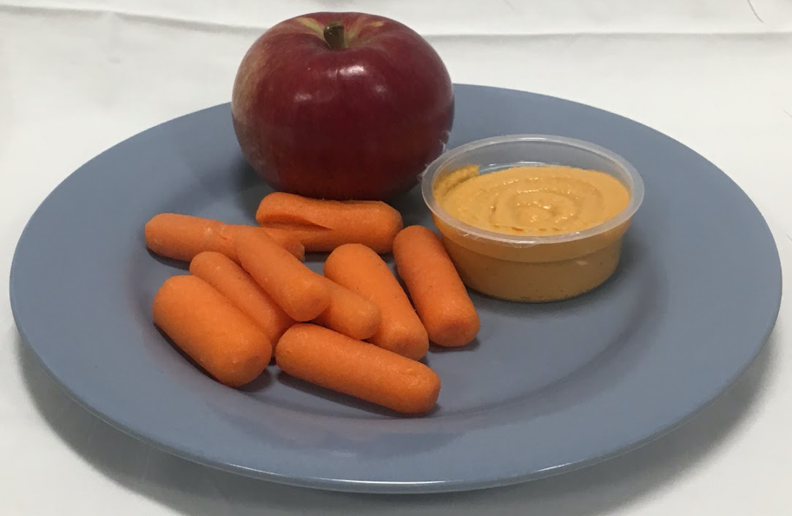


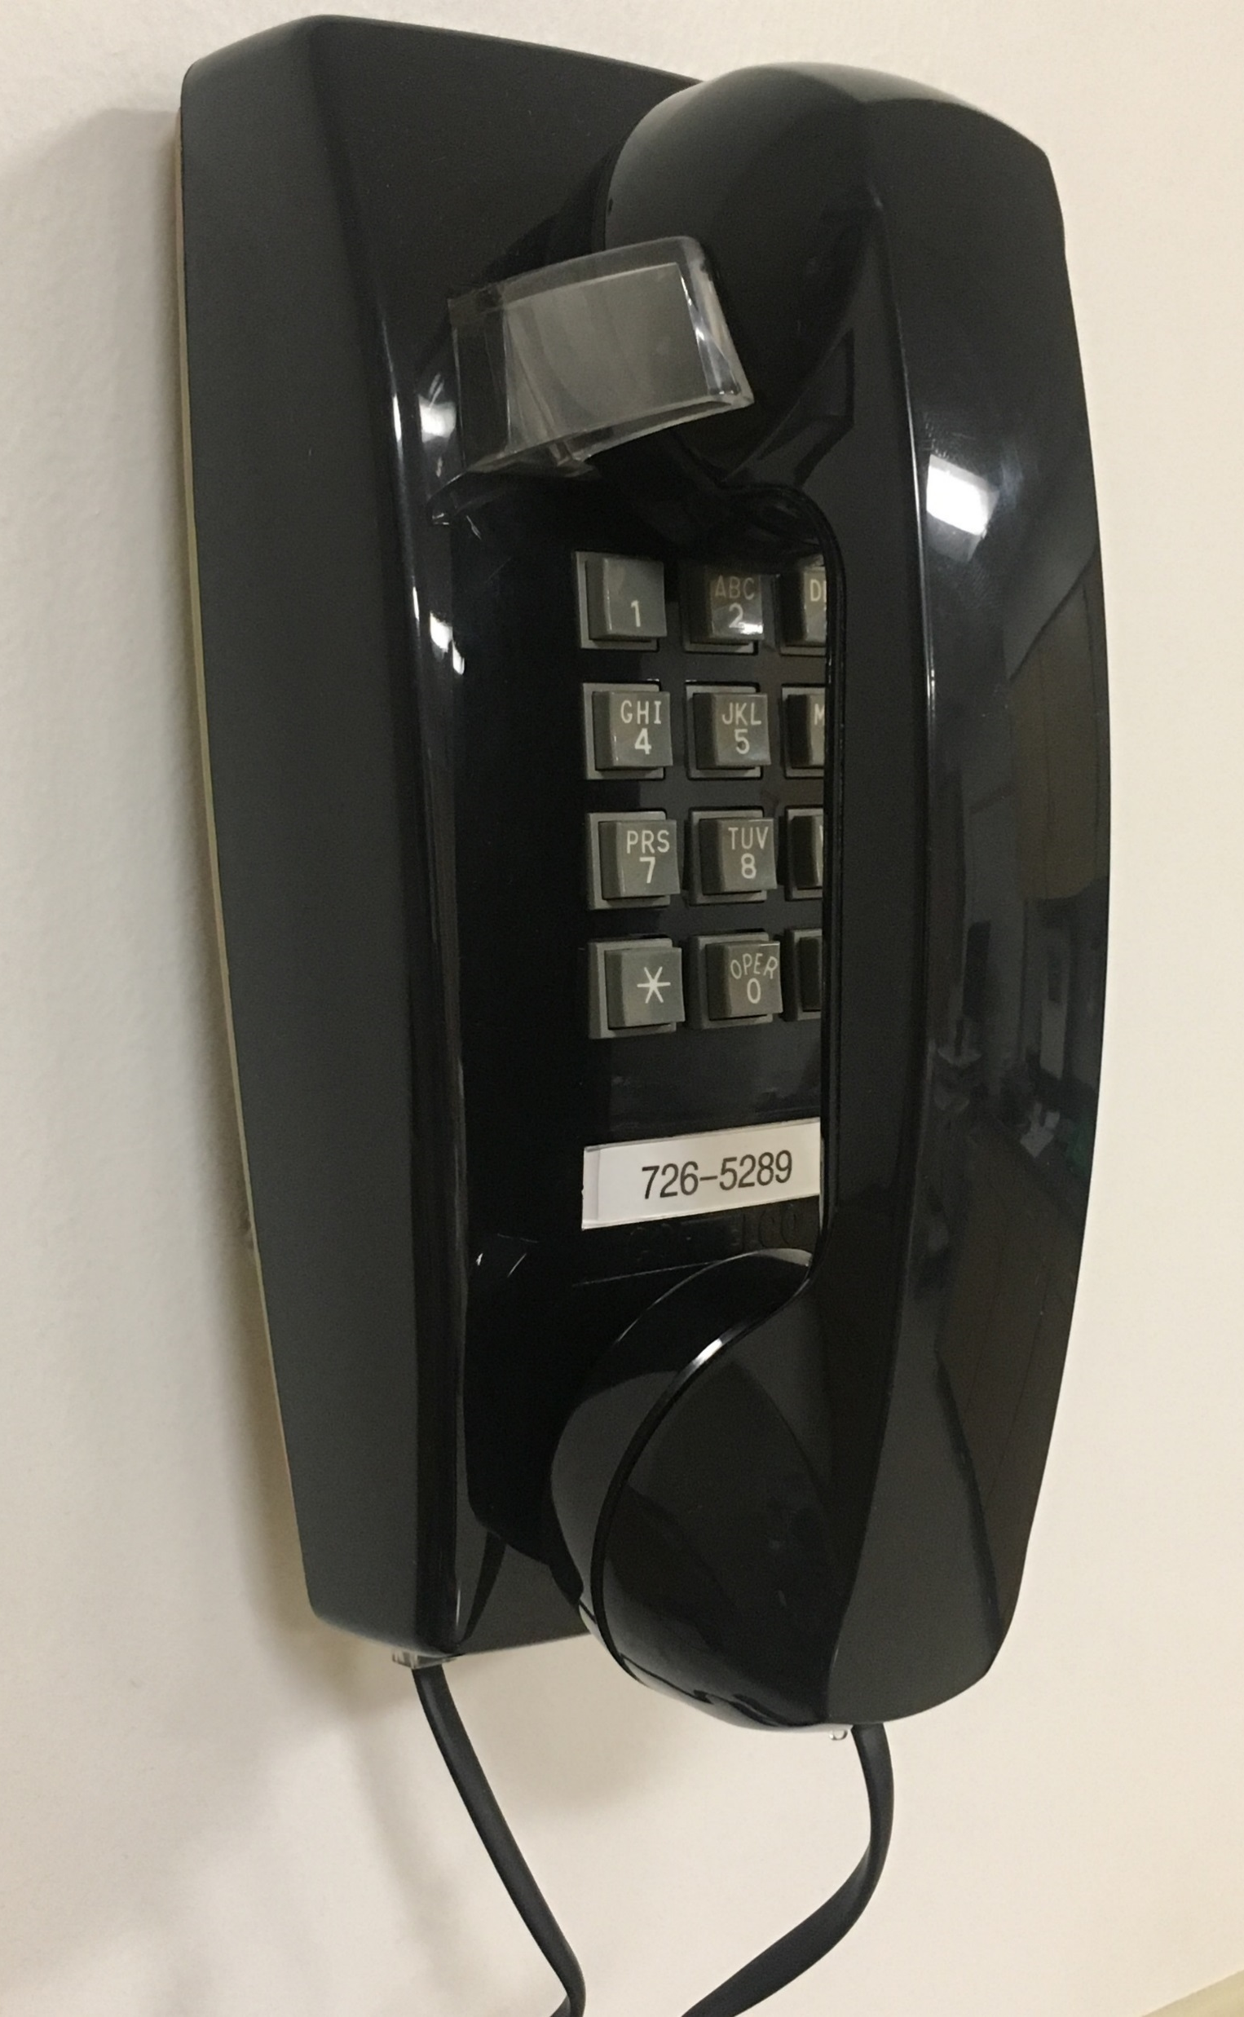
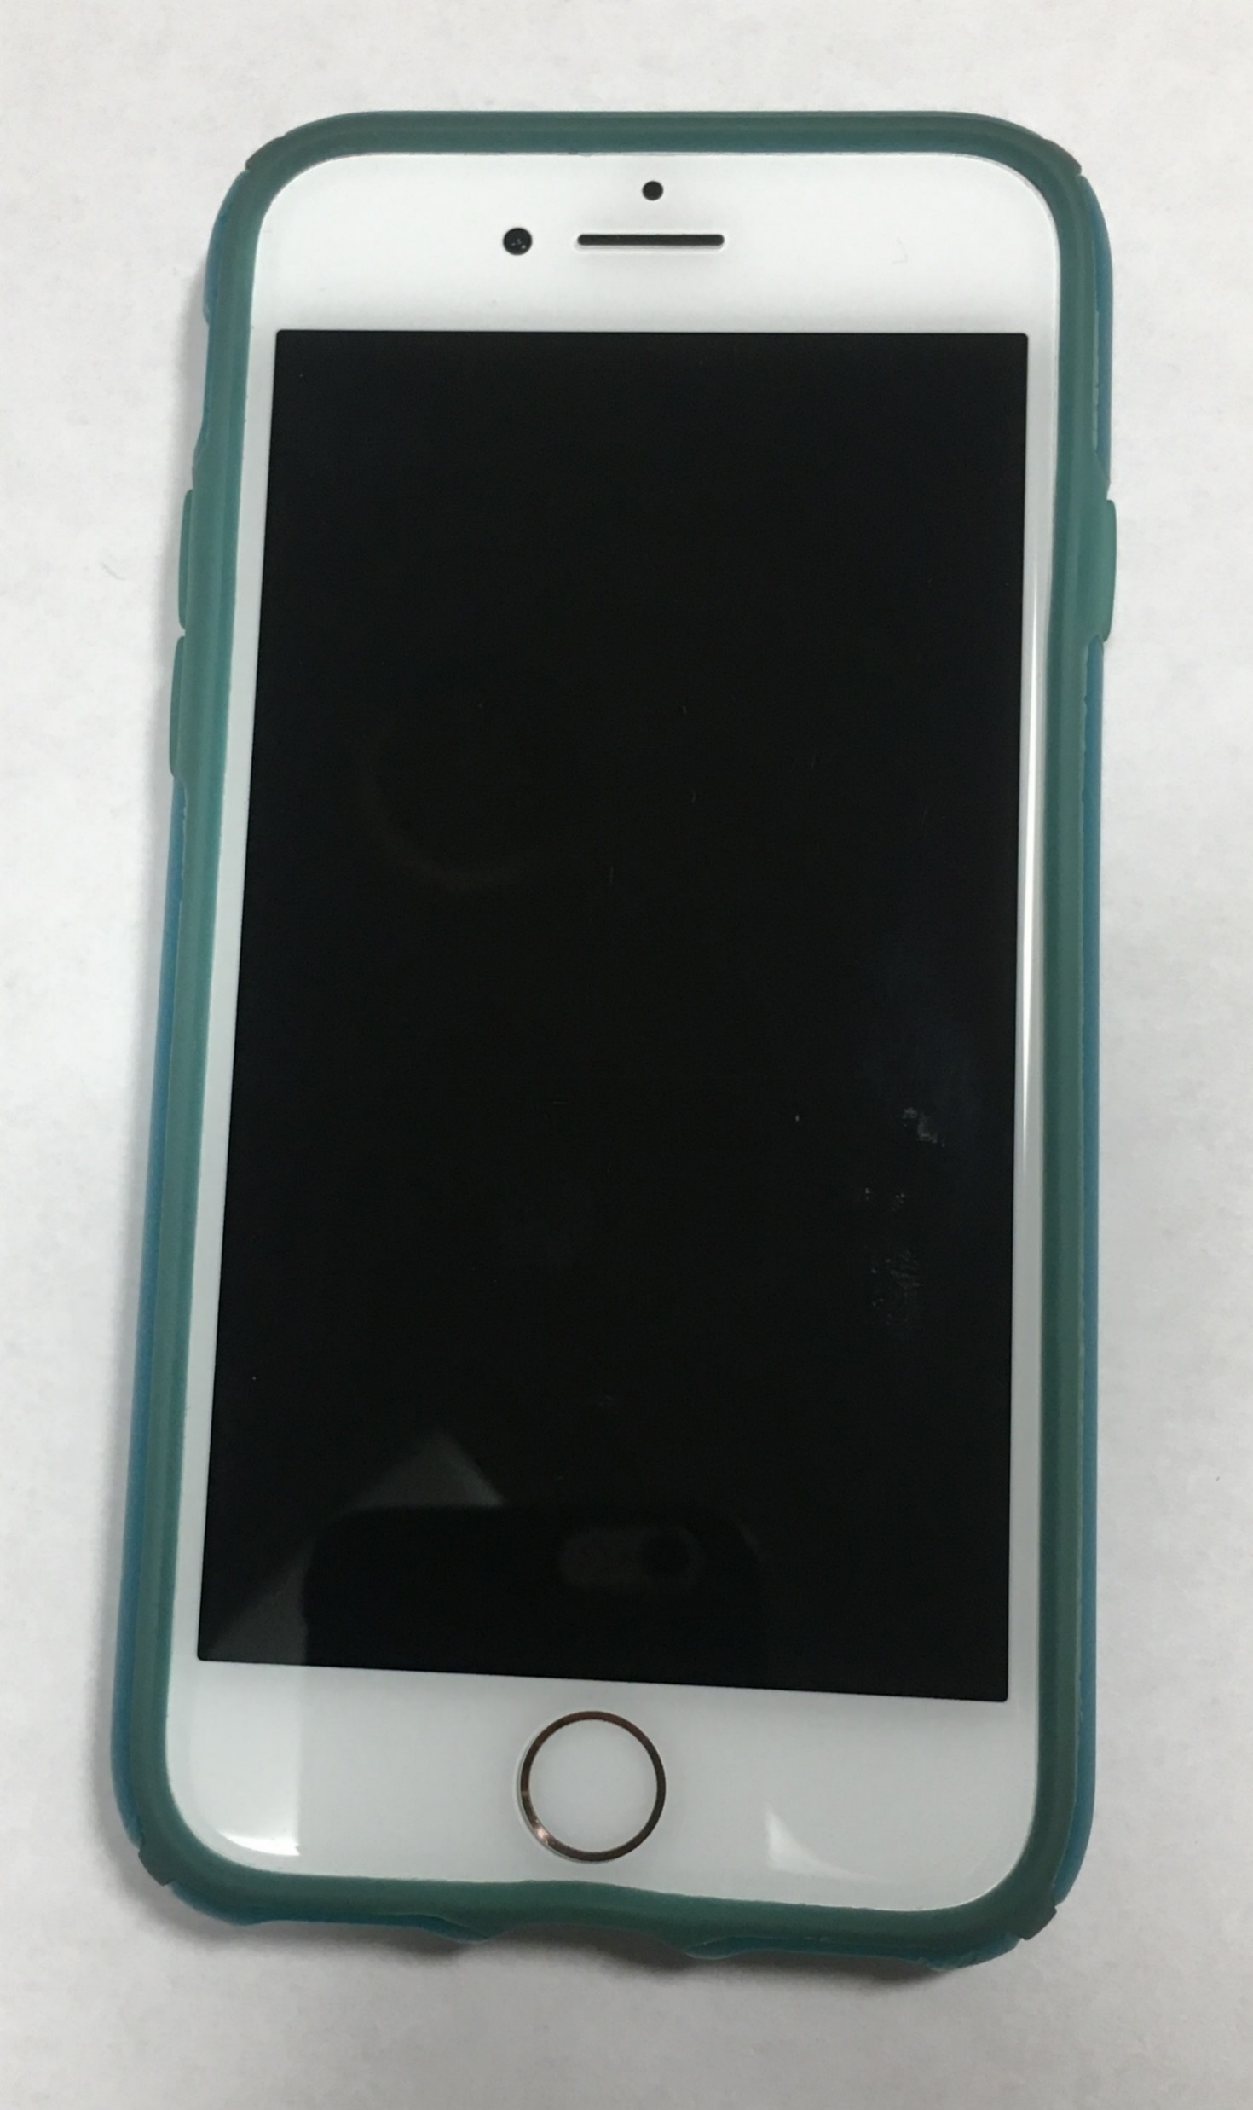
1 FIRST | 2 THEN | þ DONE
EAT
DRINK
PAIN
POLICE/HELPER
GAME
SIT DOWN
CALL MY FAMILY
Point to targets to tell your patient what is about to happen. Say the message out loud as you point. For example, "First eat. Then game.”

Slide 15
WAIT
GO
Fold this page in half along the dotted line. Cue your patient when it is time to wait or pause an activity. Turn the page around to signal when it is time to go or resume.

Slide 16
I AM
BRAVE

Slide 17
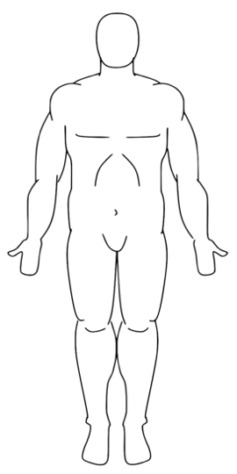



I AM IN PAIN
0 | 1 | 2 | 3 | 4 | 5 | 6 | 7 | 8 | 9 | 10
Adult Pain Scale

