Slide 1
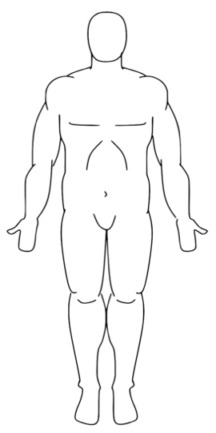
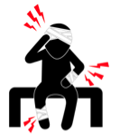


I AM IN PAIN
0 | 1 | 2 | 3 | 4 | 5 | 6 | 7 | 8 | 9 | 10
Adult Pain Scale
Notes:
Pain Board

Slide 2
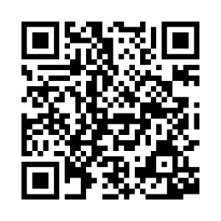
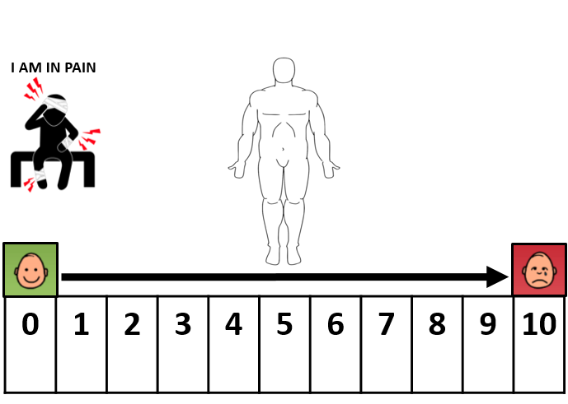
If it’s hard for patient to point, please use “partner-assisted scanning”
This is how:
Ask patient to focus on the communication board
Establish patient’s “yes” (i.e. nodding, blinking, thumbs up, etc.)
1. Proceed cell by cell across the pain scale. Point to each item and ask if that is the patient’s pain level.
2. Patient will signal the desired pain scale value using established YES response.
3. Confirm the selection & repeat if necessary.
Additional Considerations:
Hold this tool ~12 inches (~30 cm) from the patient’s face.
Ensure good lighting, head positioning, and vision.
Speak loudly and clearly using simple language.
Wearing masks and other PPE may make it difficult to understand speech. Consider using communication tools when speaking to the patient as well.
If the patient can’t use this tool effectively now, that does not mean the patient won’t be able to use it later today, tomorrow, or this week. Continue to provide opportunities to support communication.
Partner-Assisted Scanning Instructions – Pain Scale

