Slide 1
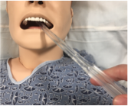
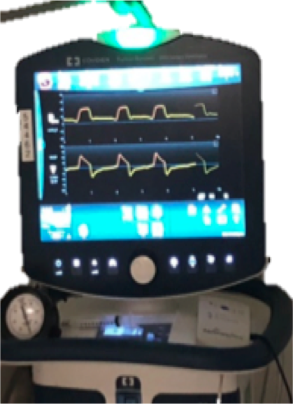
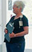
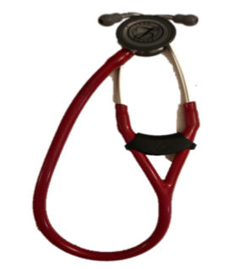

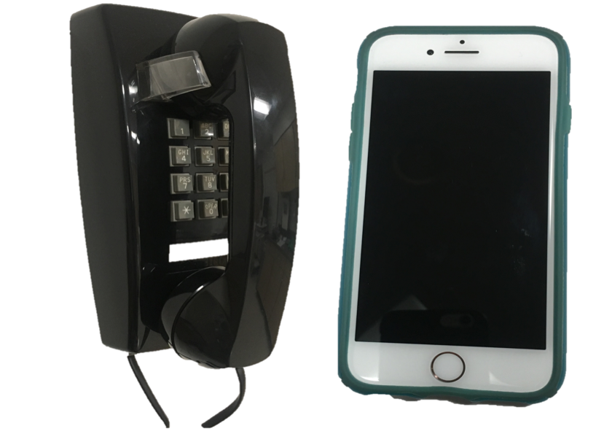


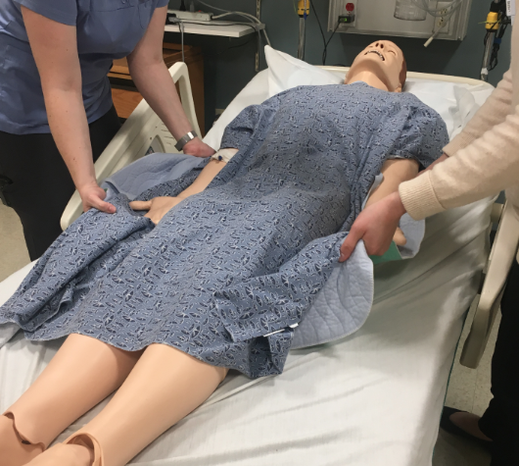
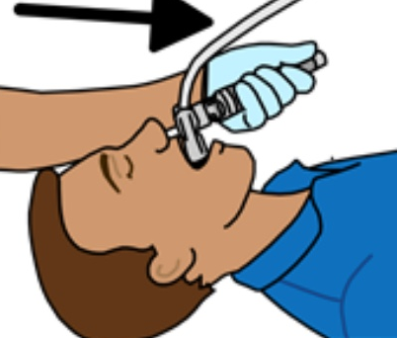
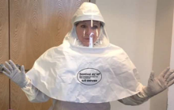





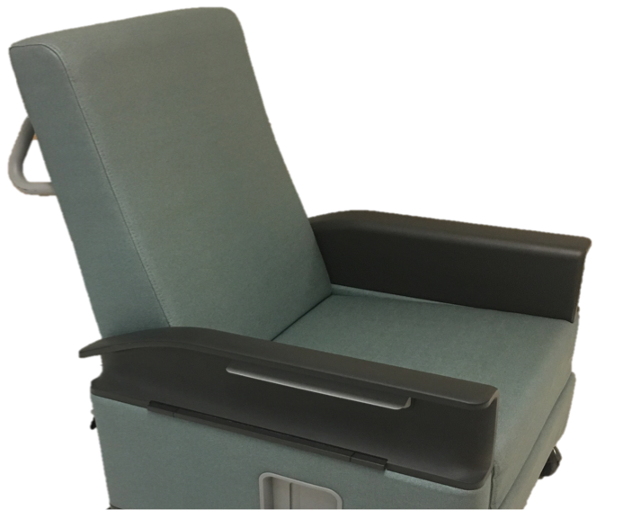

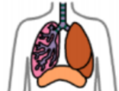
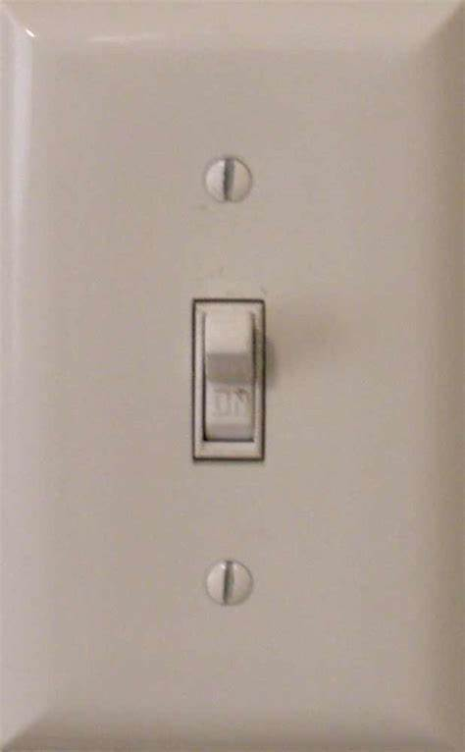

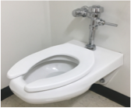

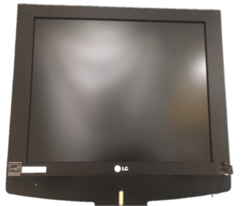
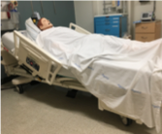
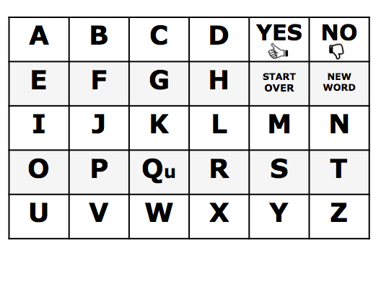
General needs – 24+ targets – photo & text
SUCTION | VENTILATOR | ANXIOUS/ SCARED | NURSE | DOCTOR | CALL MY FAMILY
PAIN | BREATHING TUBE | HOT COLD | REPOSITION | PROTECTIVE EQUIPMENT | WHAT’S MY STATUS?
MEDICINE | TROUBLE BREATHING | THIRSTY | LIGHTS ON / OFF | CHAIR | NO VISITORS
MOUTH CARE | BATHROOM | TIME / DAY ? | TV ON / OFF | BED | LETTER BOARD
MAYBE | DON’T KNOW | LATER

Slide 2
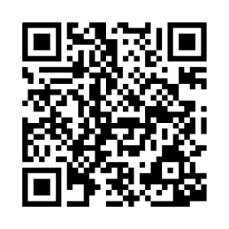
If it’s hard for patient to point, please use “partner-assisted scanning”
This is how:
Ask patient to focus on the communication board and find the message they want to communicate.
Establish patient’s “yes” (i.e. nodding, blinking, thumbs up, etc.)
1. Proceed row by row. Point to each row and ask if the desired message is in that row
(e.g. point to 1st row and ask, “Is it in this row?” followed by 2nd row, and so on)
2. Patient will select a row using the established YES response. Verify the choice out loud.
3. Point to each message within the selected row (“Is it suction?” “Trouble breathing,” etc.).
4. Patient will signal that you are pointing to the desired message using established YES response.
5. Confirm the selection & repeat.
Additional Considerations:
Hold this tool ~12 inches (~30 cm) from the patient’s face.
Ensure good lighting, head positioning, and vision.
Speak loudly and clearly using simple language.
Wearing masks and other PPE may make it difficult to understand speech. Consider using communication tools when speaking to the patient as well.
If the patient can’t use this tool effectively now, that does not mean the patient won’t be able to use it later today, tomorrow, or this week. Continue to provide opportunities to support communication.
Partner-Assisted Scanning Instructions – message board

Slide 3
SUCTION | VENTILATOR | ANXIOUS/ SCARED | NURSE | DOCTOR | CALL MY FAMILY
PAIN | BREATHING TUBE | HOT / COLD | REPOSITION | PROTECTIVE EQUIPMENT | WHAT’S MY STATUS?
MEDICINE | TROUBLE BREATHING | THIRSTY | LIGHTS ON / OFF | CHAIR | NO VISITORS
MOUTH CARE | BATHROOM | TIME / DAY? | TV ON / OFF | BED | GET THE LETTER BOARD
MAYBE | DON’T KNOW | LATER
General Need – 24+ targets – text only

Slide 4
If it’s hard for patient to point, please use “partner-assisted scanning”
This is how:
Ask patient to focus on the communication board and find the message they want to communicate.
Establish patient’s “yes” (i.e. nodding, blinking, thumbs up, etc.)
1. Proceed row by row. Point to each row and ask if the desired message is in that row
(e.g. point to 1st row and ask, “Is it in this row?” followed by 2nd row, and so on)
2. Patient will select a row using the established YES response. Verify the choice out loud.
3. Point to each message within the selected row (“Is it suction?” “Trouble breathing,” etc.).
4. Patient will signal that you are pointing to the desired message using established YES response.
5. Confirm the selection & repeat.
Additional Considerations:
Hold this tool ~12 inches (~30 cm) from the patient’s face.
Ensure good lighting, head positioning, and vision.
Speak loudly and clearly using simple language.
Wearing masks and other PPE may make it difficult to understand speech. Consider using communication tools when speaking to the patient as well.
If the patient can’t use this tool effectively now, that does not mean the patient won’t be able to use it later today, tomorrow, or this week. Continue to provide opportunities to support communication.
Partner-Assisted Scanning Instructions – message board

